Slide 1


Traffic Sign
Detection & Recognition
Group Members
樊斯特 12111624
肖佳辰 12112012

Slide 2


Contents
01
/Introduction
02
/Related Works
03
/Methodology
04
/Results
Problem Formulation
Project Overview
Novelty and Difficulty
YOLOv8
Efficient Channel Attention
Data Preprocessing
Model Training
Model Improving
Project results
Conclusion

Slide 3
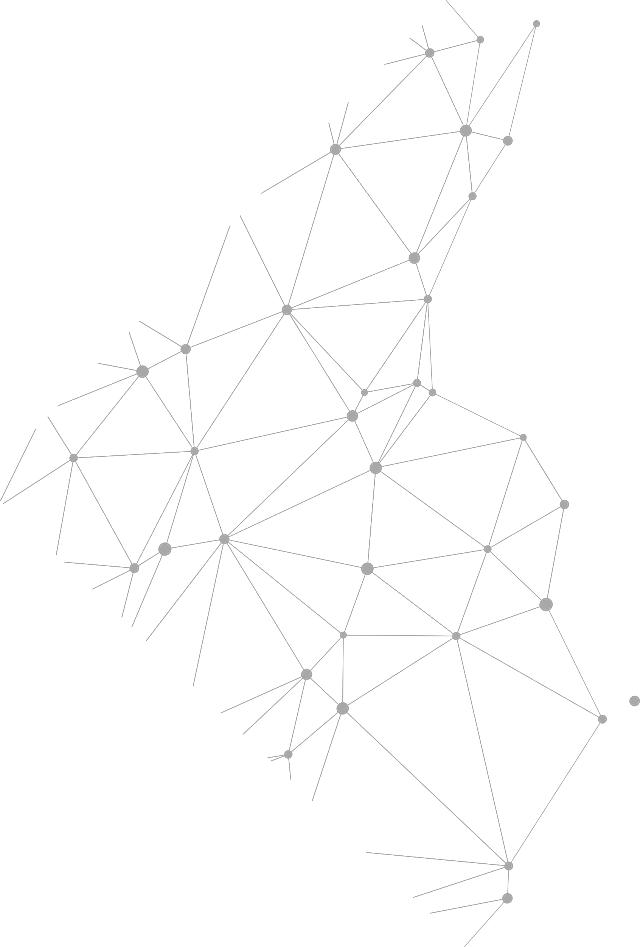

01
Introduction

Slide 4
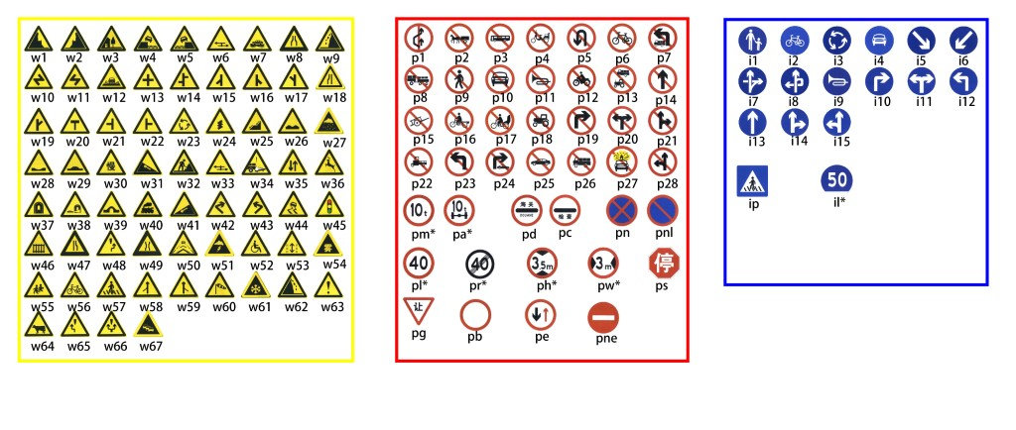
Problem Formulation
Dataset: TT1000K[1]
https://cg.cs.tsinghua.edu.cn/traffic-sign/
[1]Z. Zhu, D. Liang, S. Zhang, X. Huang, B. Li, and S. Hu, “Traffic-Sign Detection and Classification in the Wild,” 2016.

Slide 5
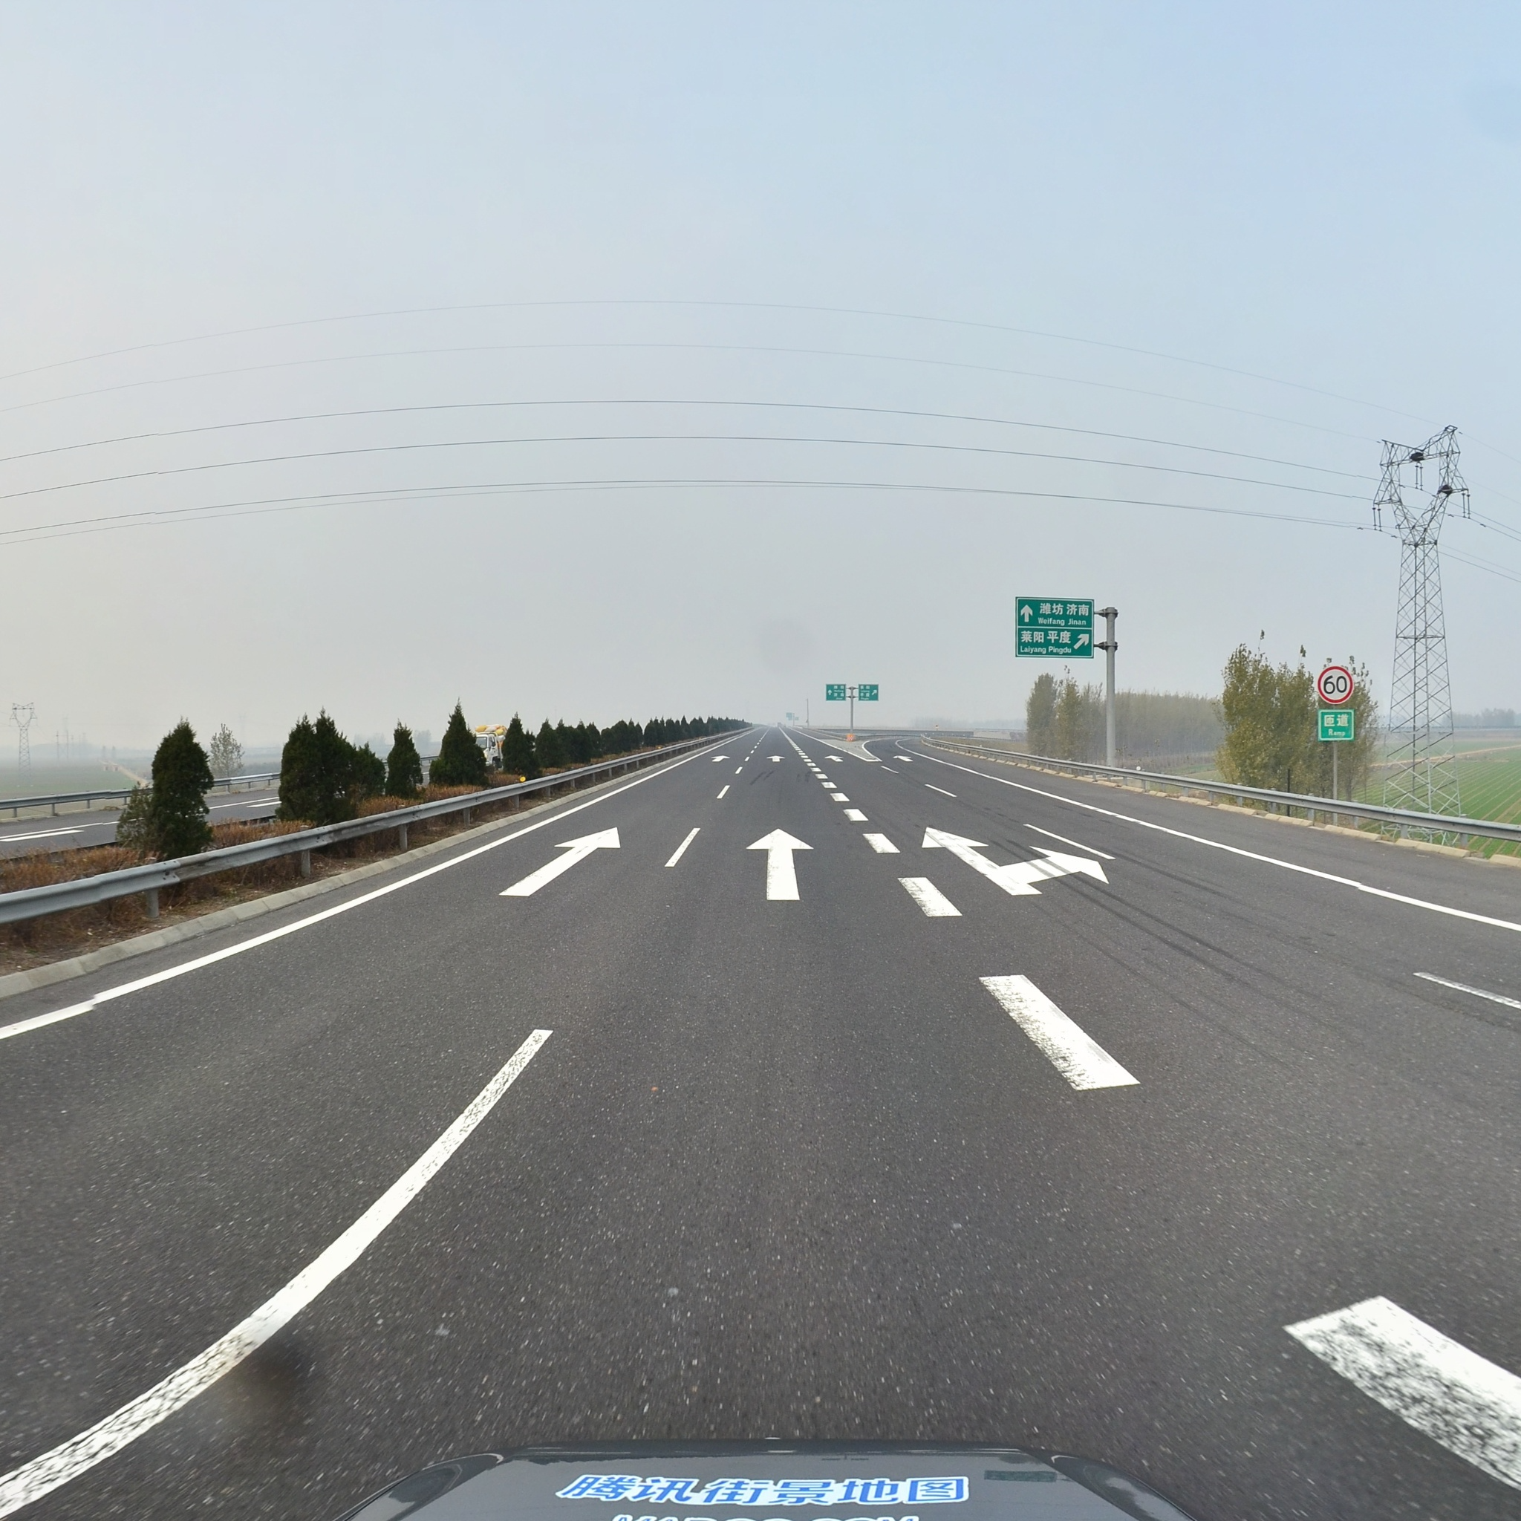
Problem Formulation
Dataset: TT1000K[1]
100,000 Tencent Street View panoramas.
30,000 containing traffic sign
Different weather conditions…
"3344": {
"path": "train/3344.jpg",
"id": 3344,
"objects": [
{
"bbox": {
"xmin": 1775.0,
"ymin": 897.0,
"xmax": 1822.0,
"ymax": 949.0
},
"category": "pl60"
}
]
},
[1]Z. Zhu, D. Liang, S. Zhang, X. Huang, B. Li, and S. Hu, “Traffic-Sign Detection and Classification in the Wild,” 2016.

Slide 6
Project Goal
State-of-the-art Model Evaluation✅
Literature review ✅
Multiple models training, evaluation and selection✅
Improve the selected model ✅
Try to refine the best model (YOLOv8) using various methods ✅
Compare the refined model with the original one ✅
Collect customize dataset and evaluation ✅
In-SUSTech Dataset and Wild Dataset: images + videos ✅

Slide 7
Novelty of Our Project
State-of-the-art basic Model: YOLOv8 series
Compared: Faster R-CNN,TSR-YOLO, YOLOv8n, YOLOv8x
Light-weight SE and ECA attention mechanism refining
Similar idea from how TSR-YOLO refines YOLOv4-tiny
Extended custom datasets, as a compliment of TT1000K
Cons of TT1000K: Little data for some signs like pl15

Slide 8
02
Related Work

Slide 9
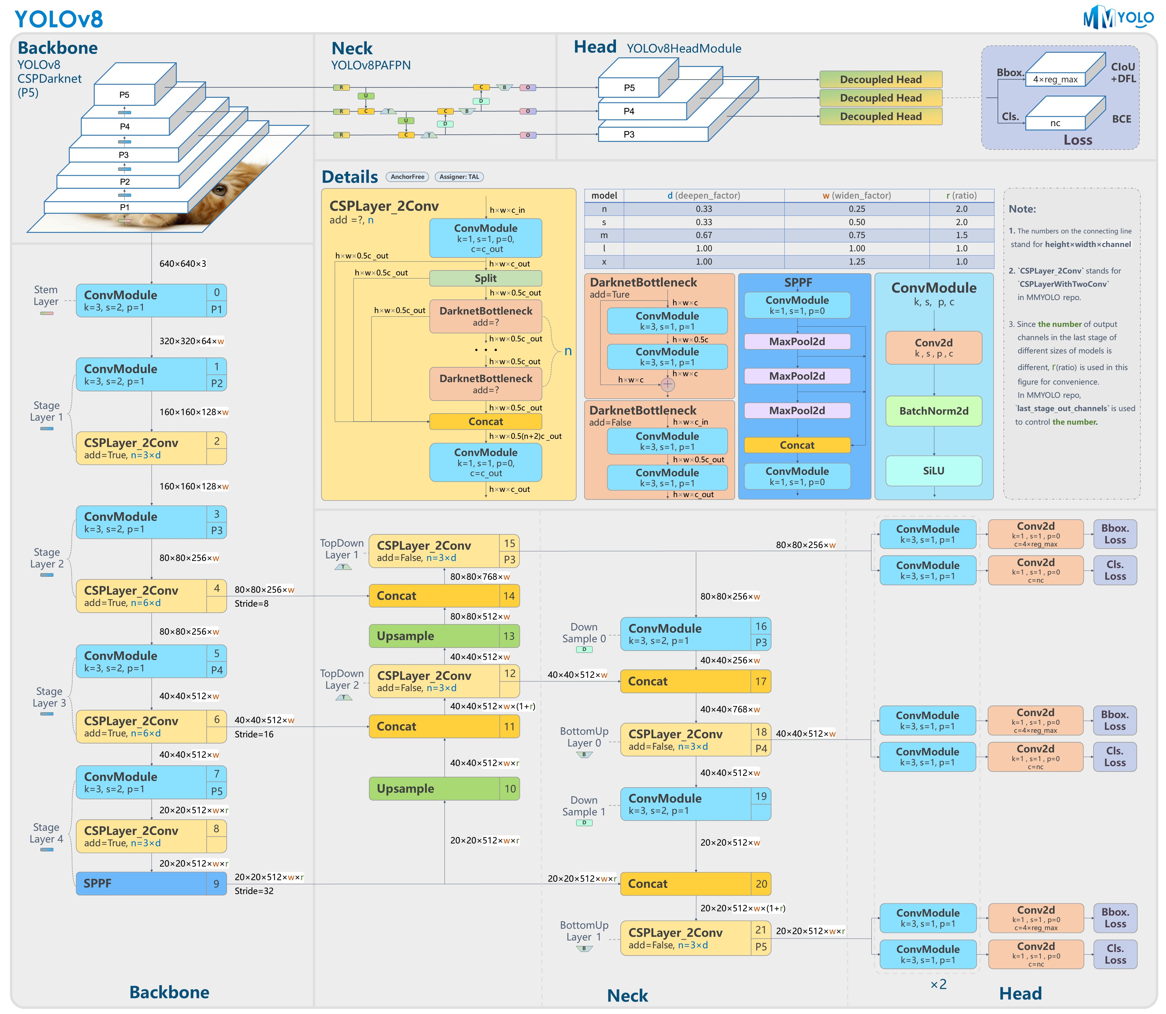
YOLOv8
Open-source, easy to modify
state-of-the-art model
Faster, more accurate, and simpler than YOLOv5
Real-time Object Detection
Backbone-Neck-Head
Multiple models: n, s, m, l, x

Slide 10
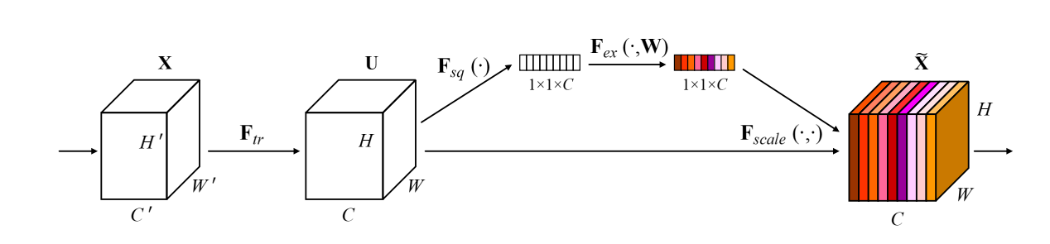
Attention Modules
Squeeze-and-Excitation Networks
Channel-wise Feature Recalibration
Squeeze and Excitation Operations
Performance Boost
Compatibility
[1] J. Hu, L. Shen, S. Albanie, G. Sun, and E. Wu, "Squeeze-and-Excitation Networks," arXiv:1709.01507 [cs.CV], 2019.

Slide 11
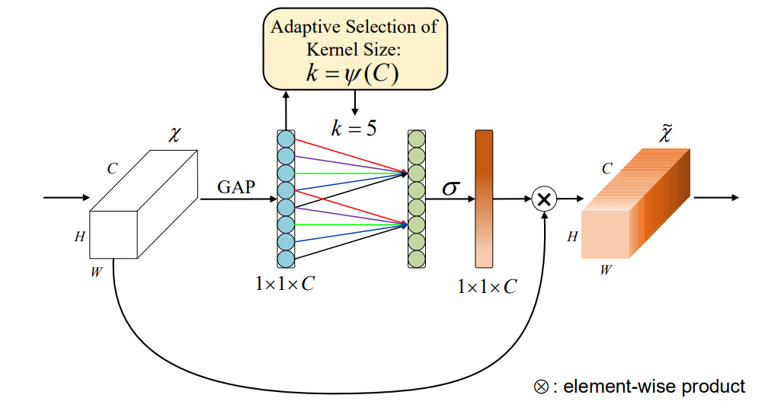
Attention Modules
Efficient Channel Attention
Efficiency
Local Cross-Channel Interaction
Adaptive Selection of Kernel Size
Performance Boost
Avoiding Dimensionality Reduction
Compatibility
[1] Q. Wang, B. Wu, P. Zhu, P. Li, W. Zuo, and Q. Hu, "ECA-Net: Efficient Channel Attention for Deep Convolutional Neural Networks," arXiv:1910.03151 [cs.CV], 2020.

Slide 12
03
Methodology

Slide 13
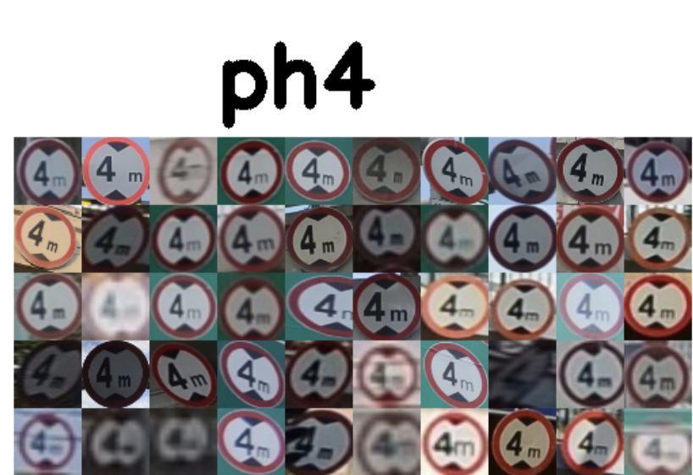
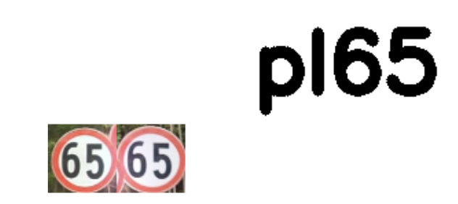
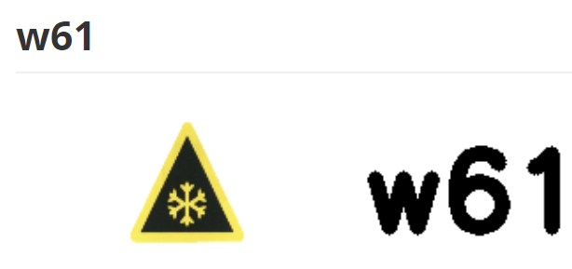
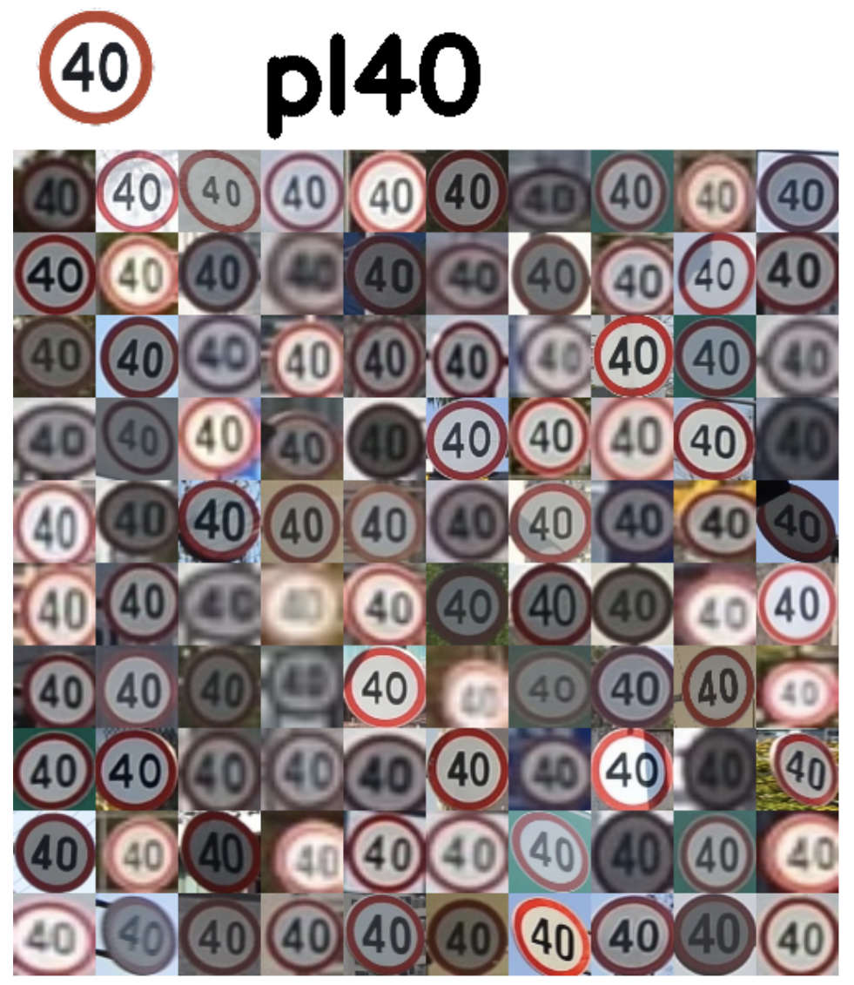
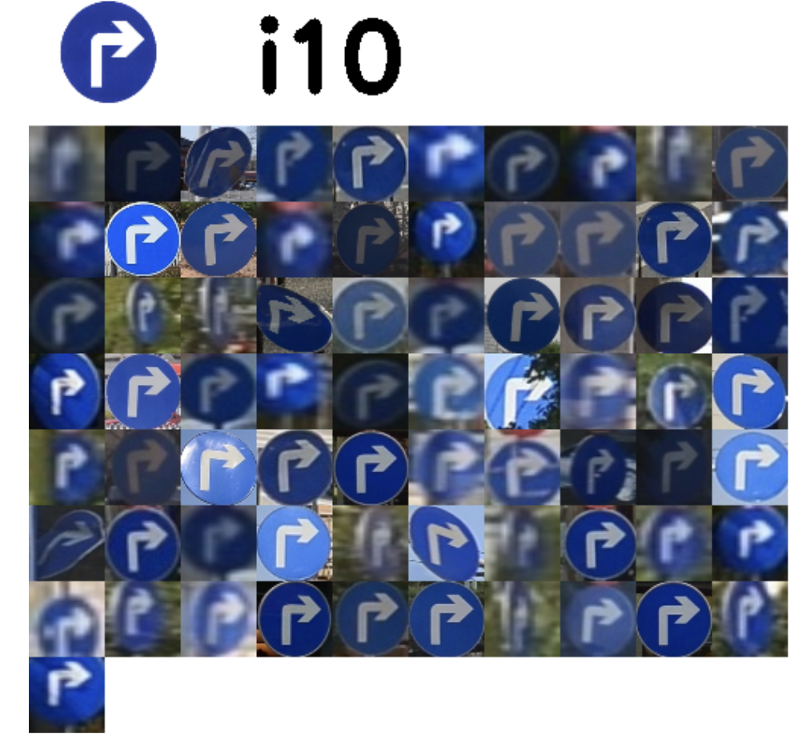
Dataset Analysis
"pl5": 537,
"pl10": 39,
"pl15": 93,
"pl20": 164,
"pl25": 8,
"pl30": 640,
"pl35": 22,
"pl40": 1413,
"pl50": 1073,
"pl60": 835,
"pl65": 2,
"pl70": 150,
"pl80": 904,
"pl90": 56,
"pl100": 673,
"pl110": 46,
"pl120": 298,
Unbalanced
Blurred case

Slide 14
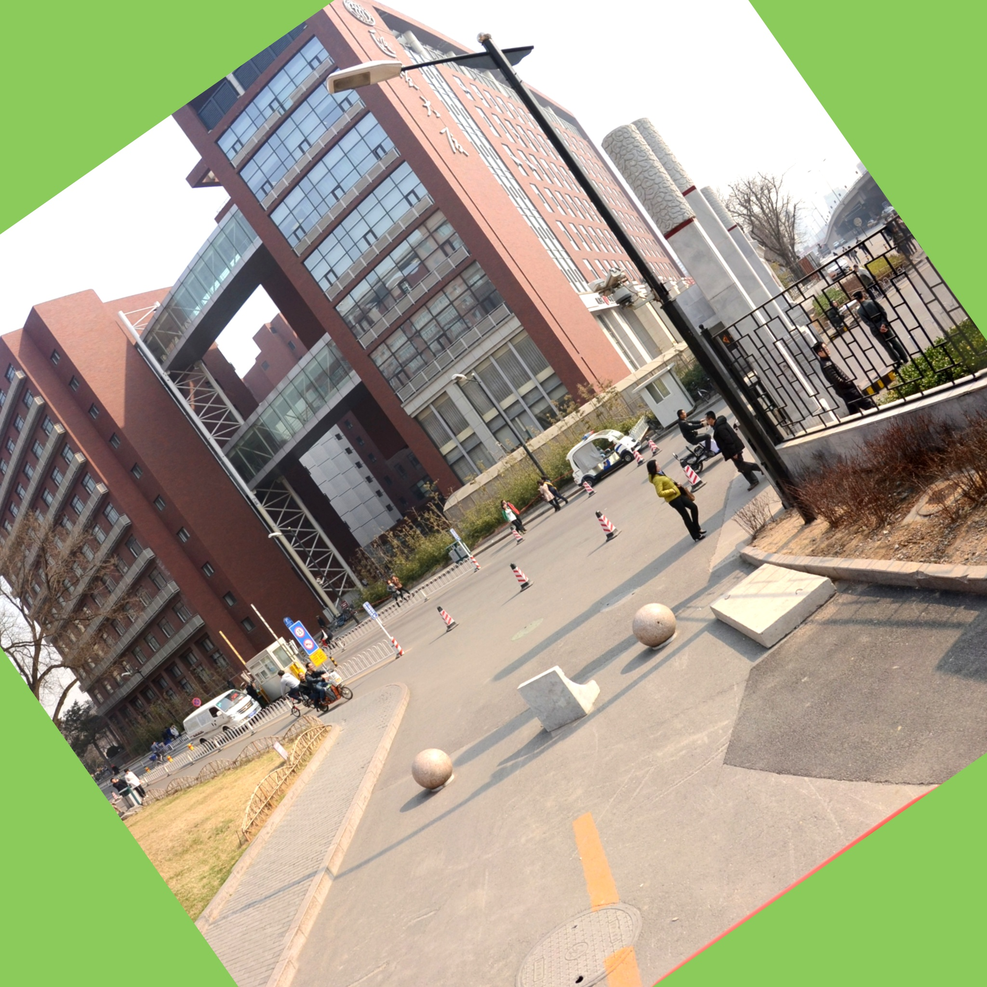
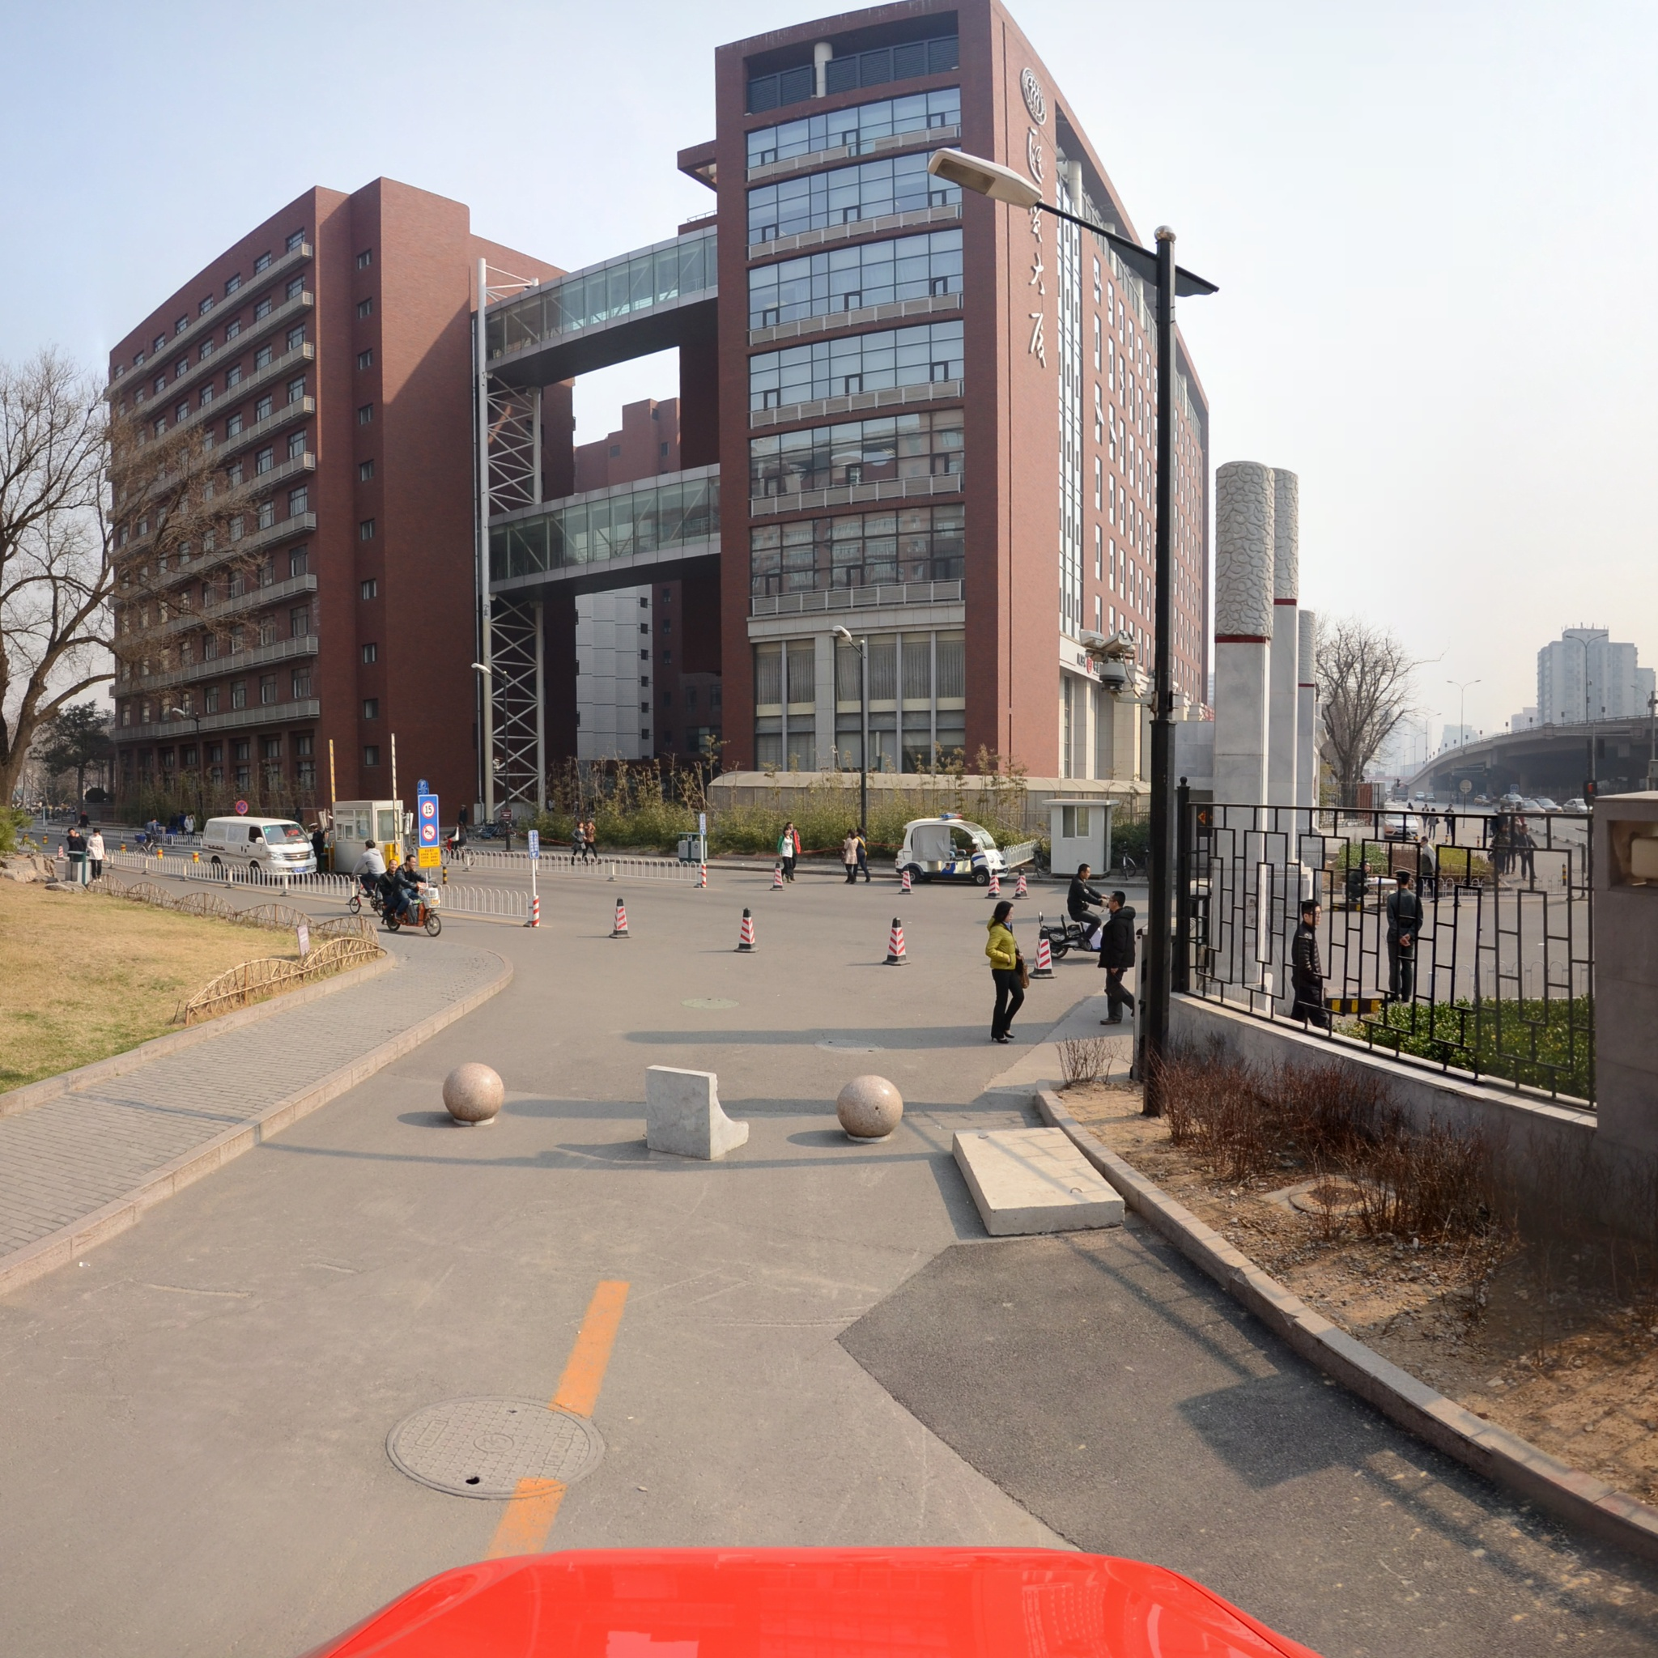
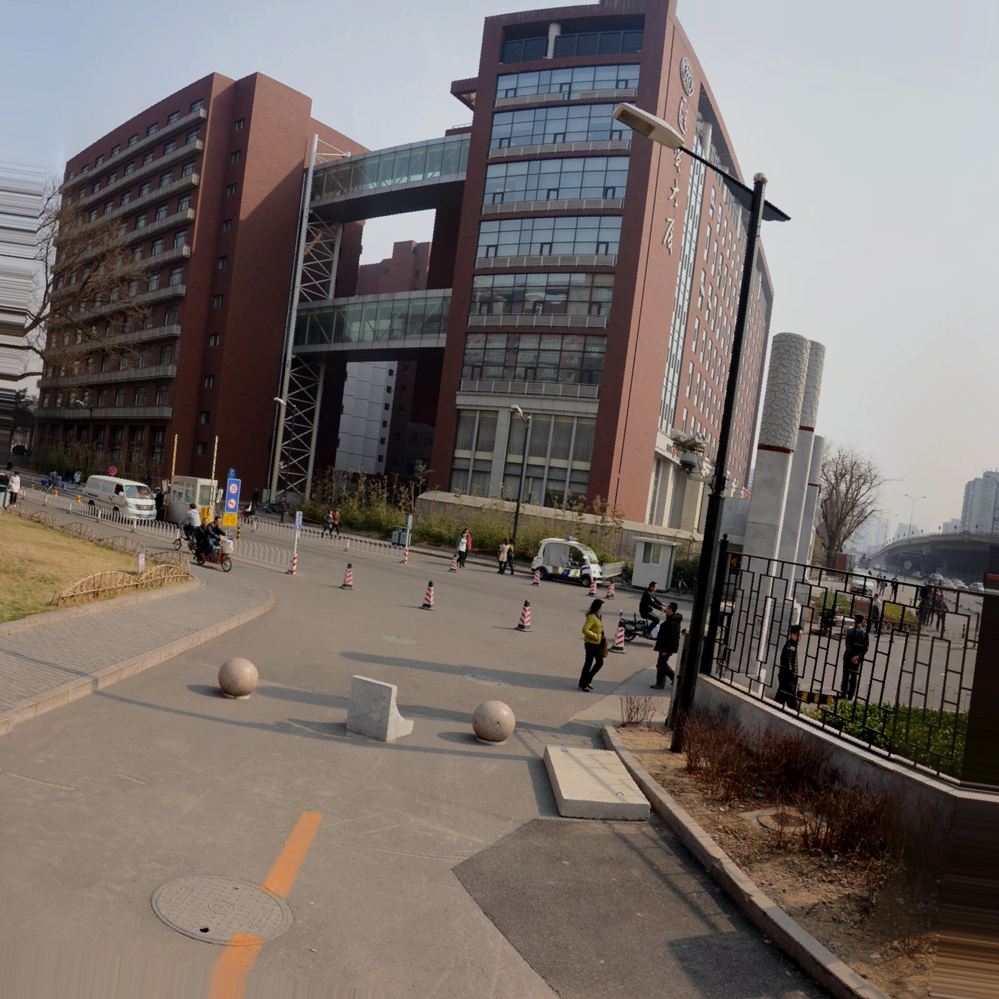
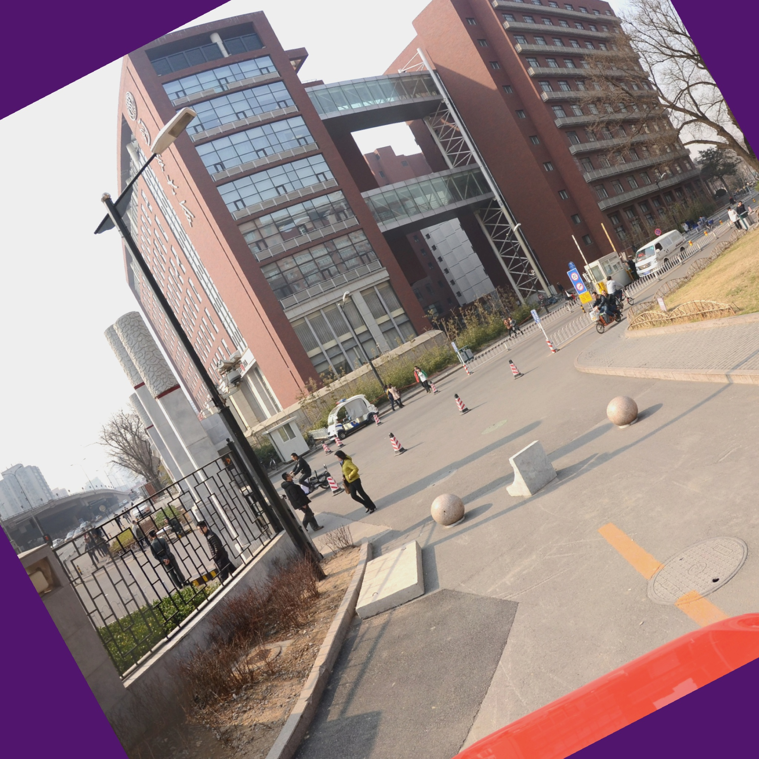



Data Preprocessing
Data Augmentation
Rotate + ISO
Gamma + Noise
Rotate + Mirror
PL15: 93 -> 93*4 = 372

Slide 15
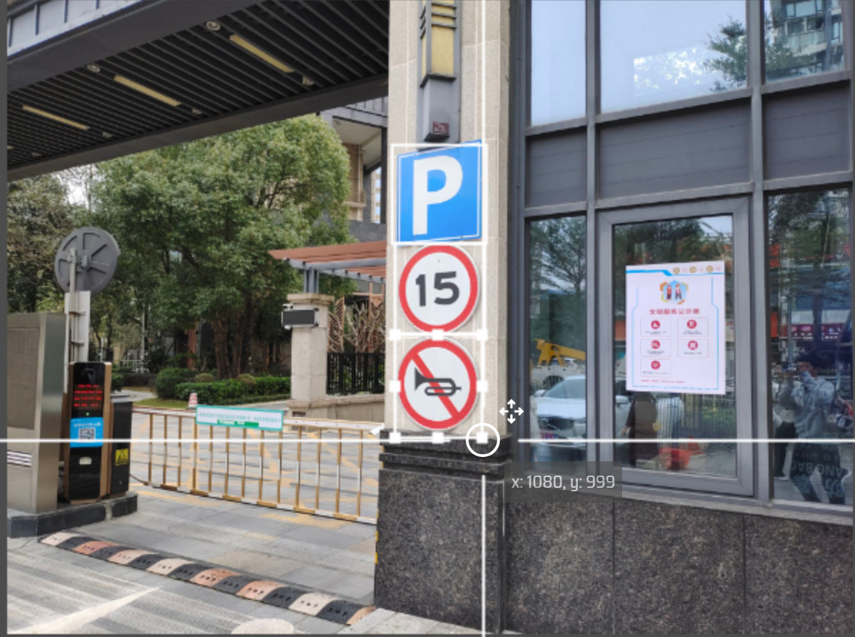
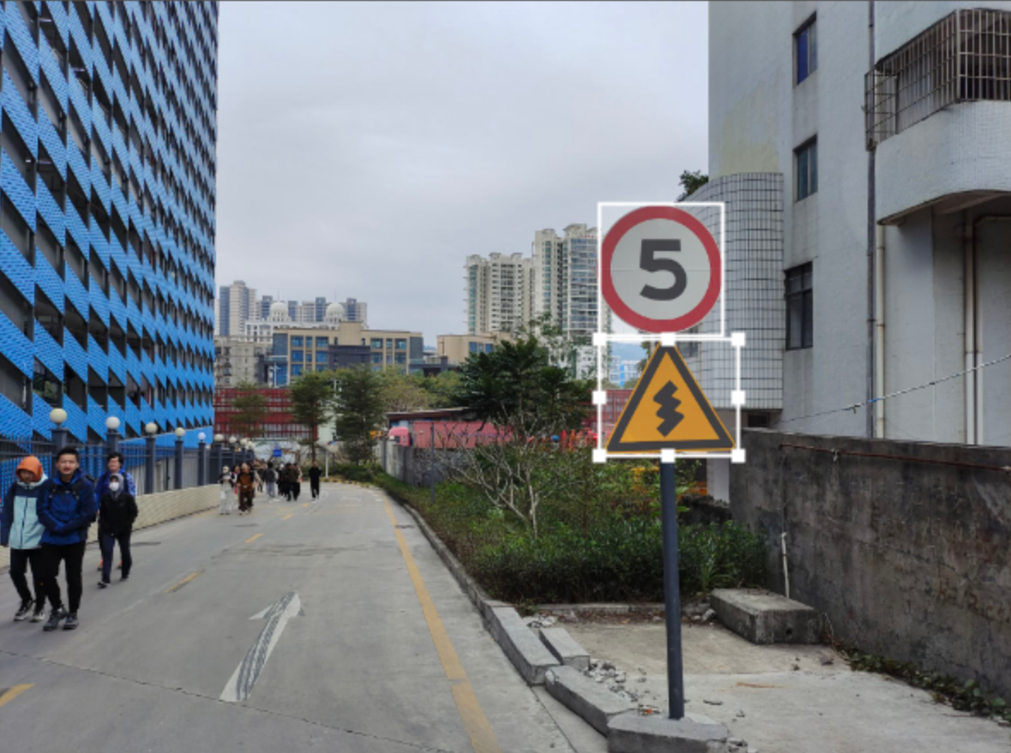
Custom Dataset
Extend Rare Signs
Manual Annotation using: https://www.makesense.ai/

Slide 16
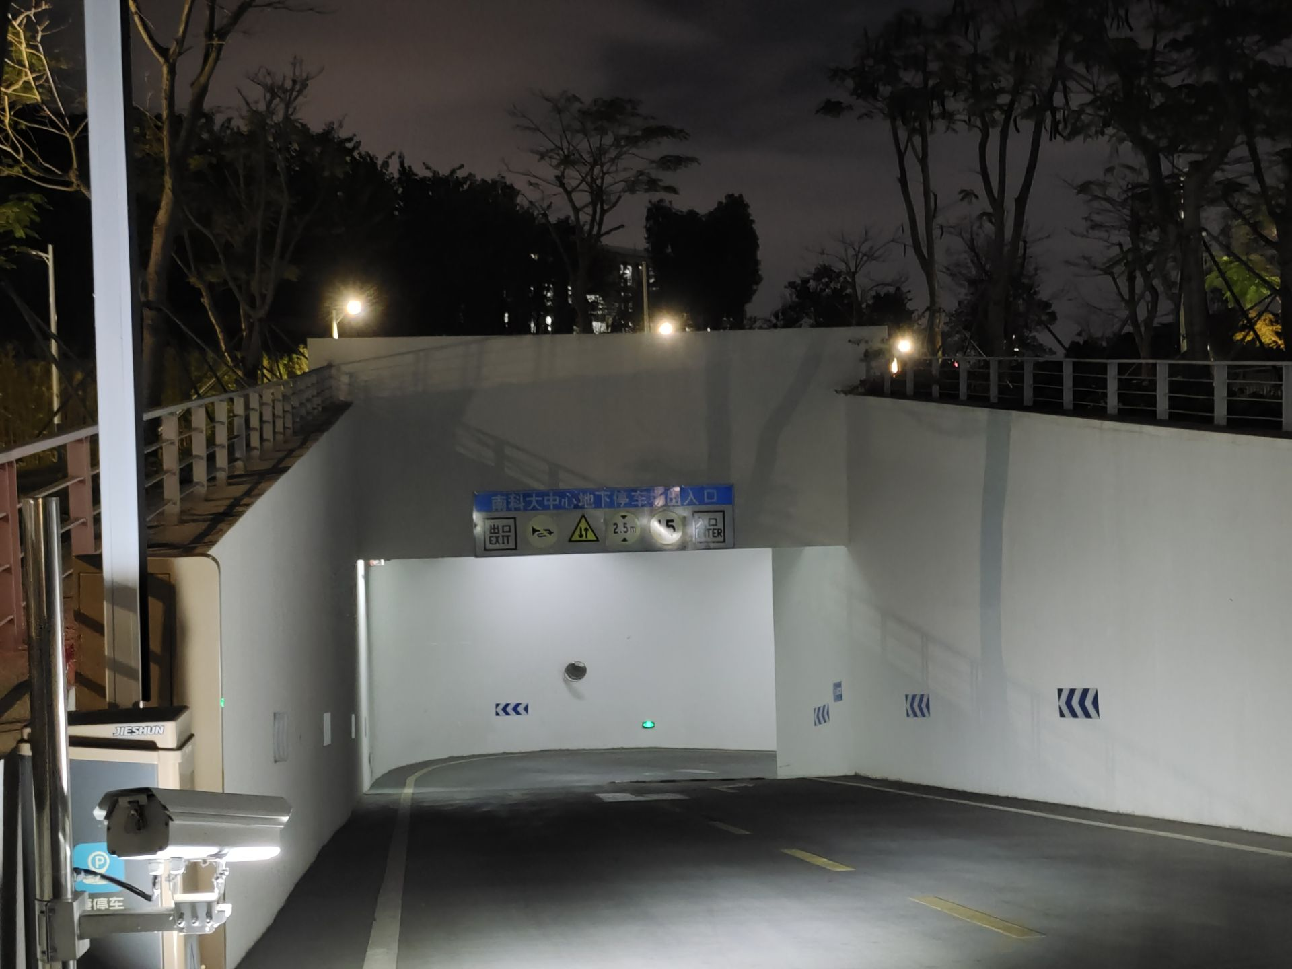
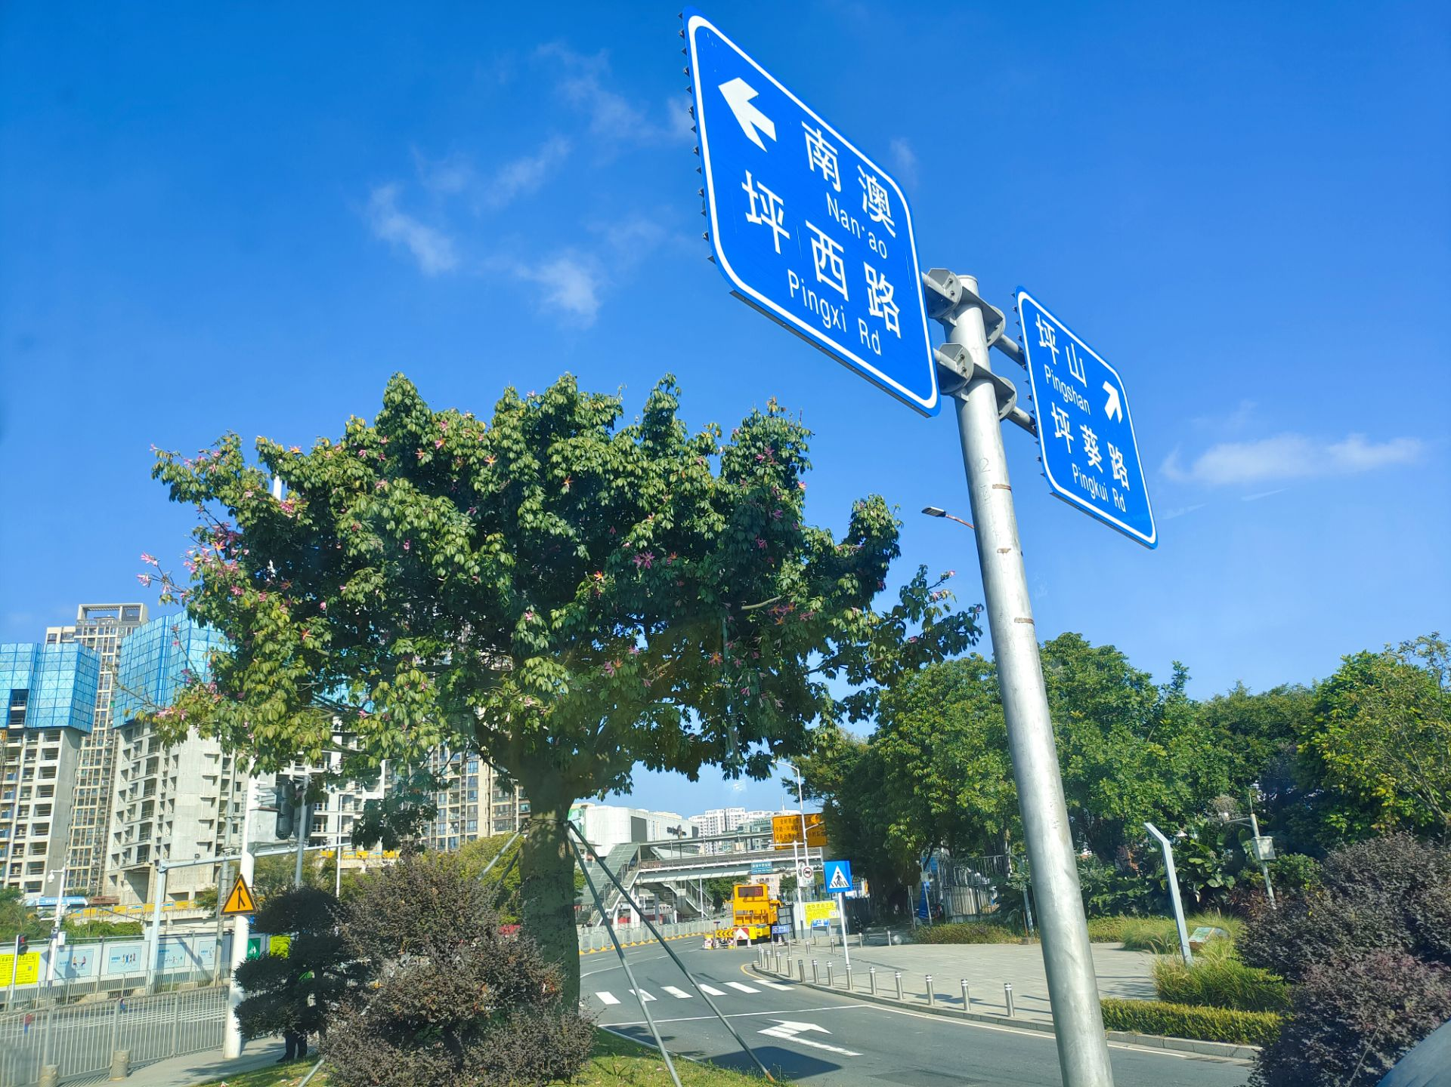
Custom Dataset
Difficult Cases
Blurred, wrong color
Multiple small signs per image
With gamma shift

Slide 17
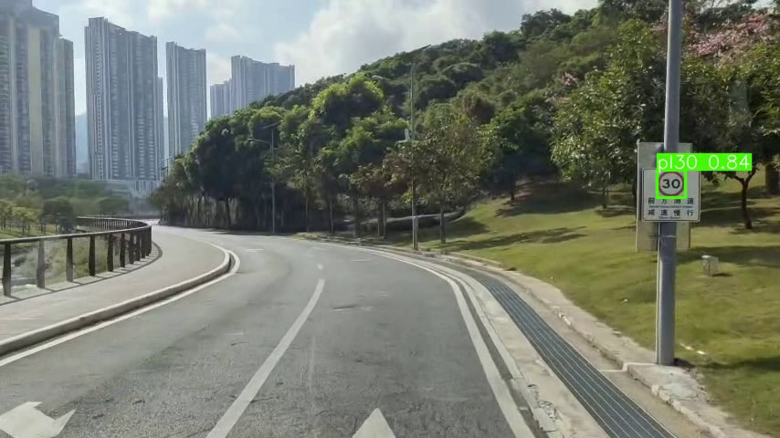
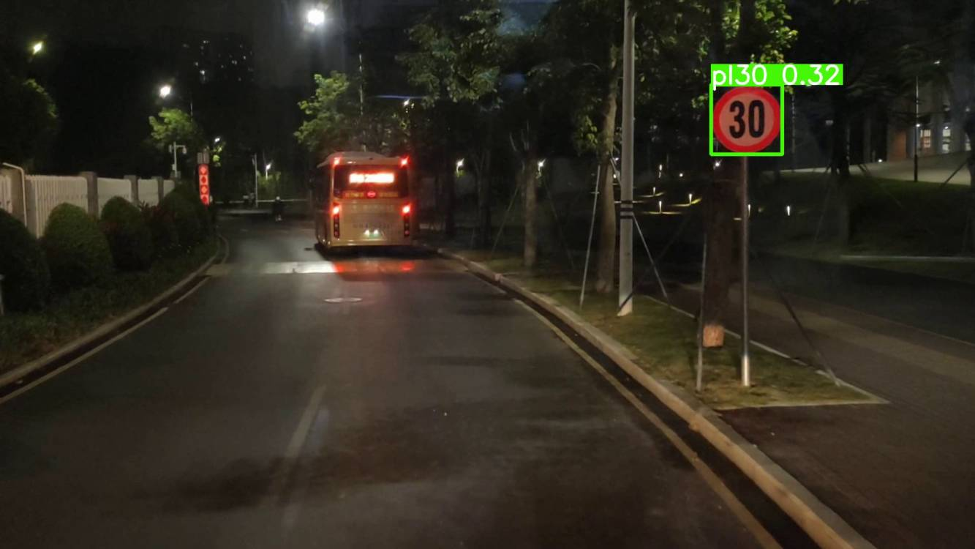
Custom Dataset
Day/Night Videos in SUSTech

Slide 18
Model Training
Base Model Selection: YOLOv8x
Attention modules added to neck network
Environment:
GPULab02 Server for Teaching in Dept.CSE
Intel(R) Xeon(R) Gold 6240 CPU \@ 2.60GHz
Control the Hyper-params

Slide 19
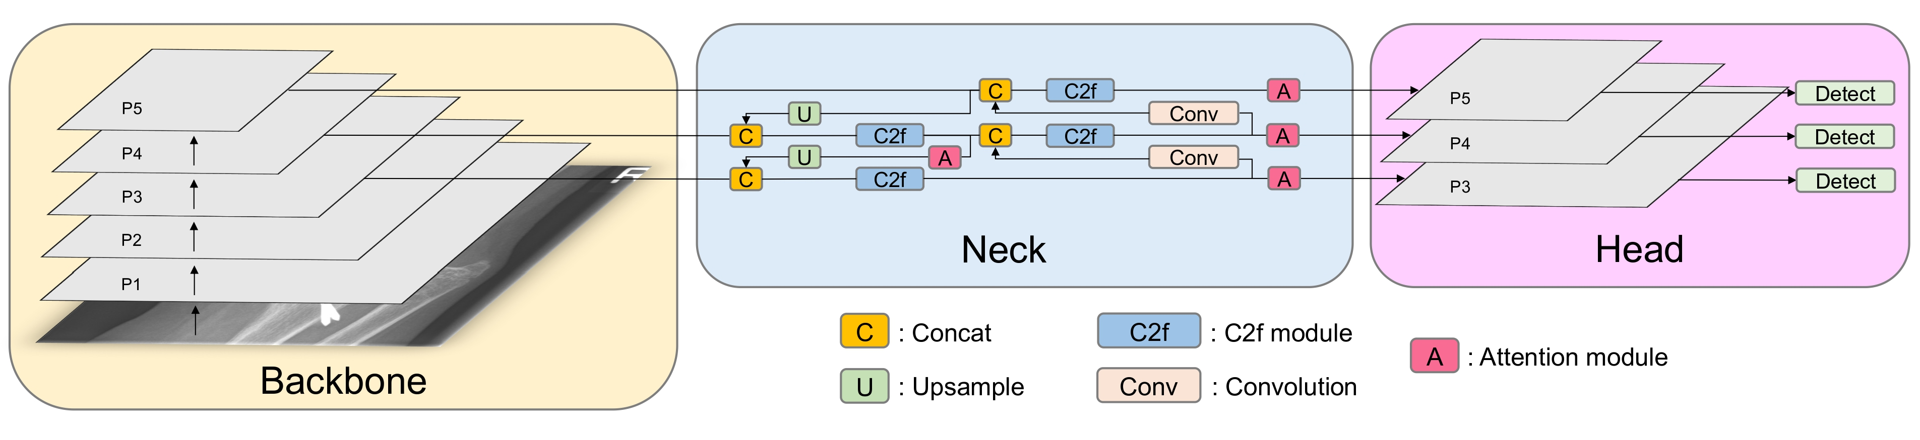
Model Improving
Modify the neck part of YOLOv8 series
Attention modules: SENet, ECA, GAM
Hyper-parameters fine-tuning

Slide 20
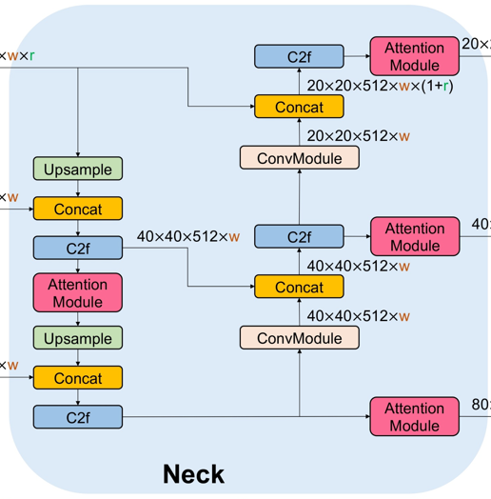
Model Improving
ECA
SE Net

Slide 21
04
Results

Slide 22
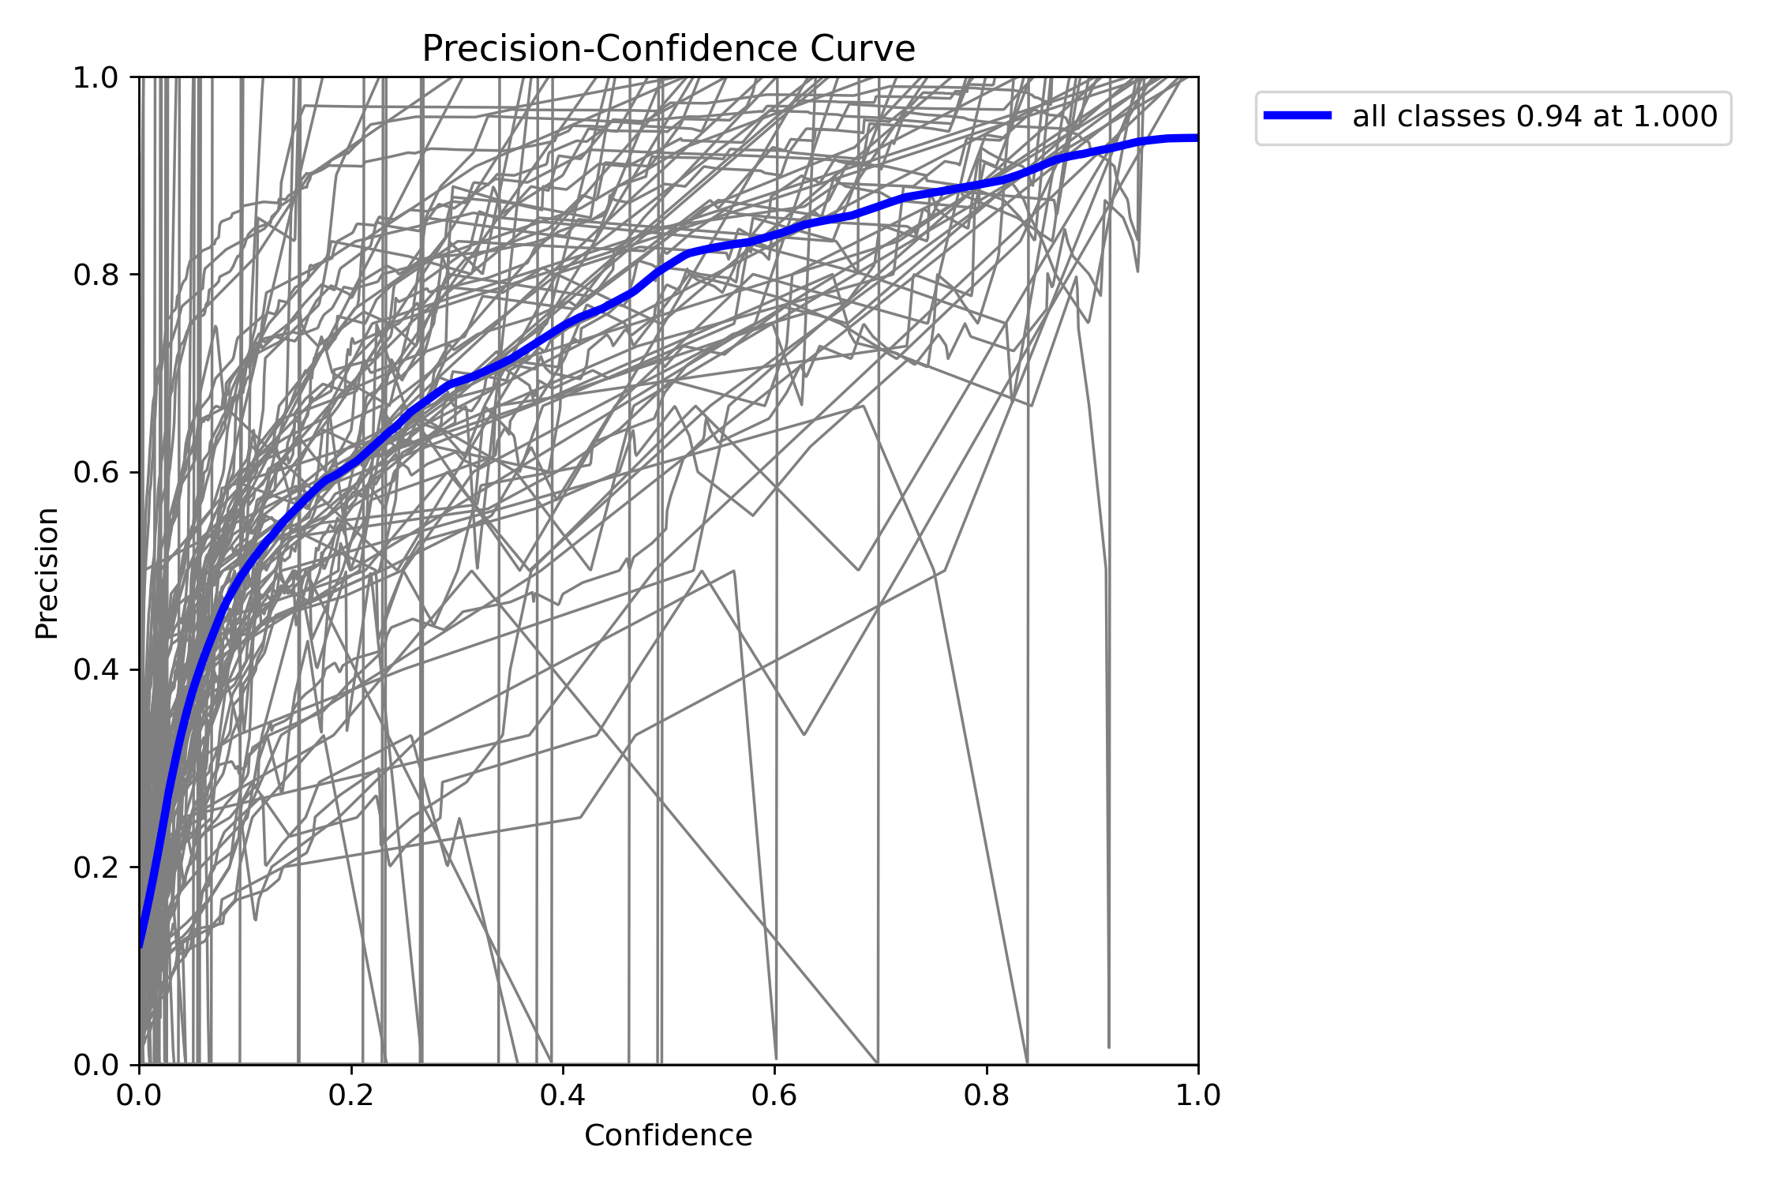
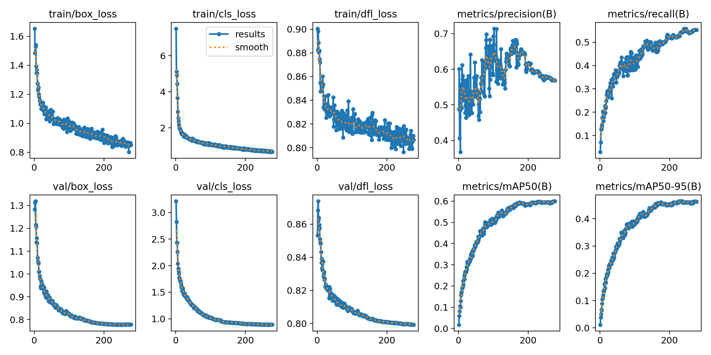
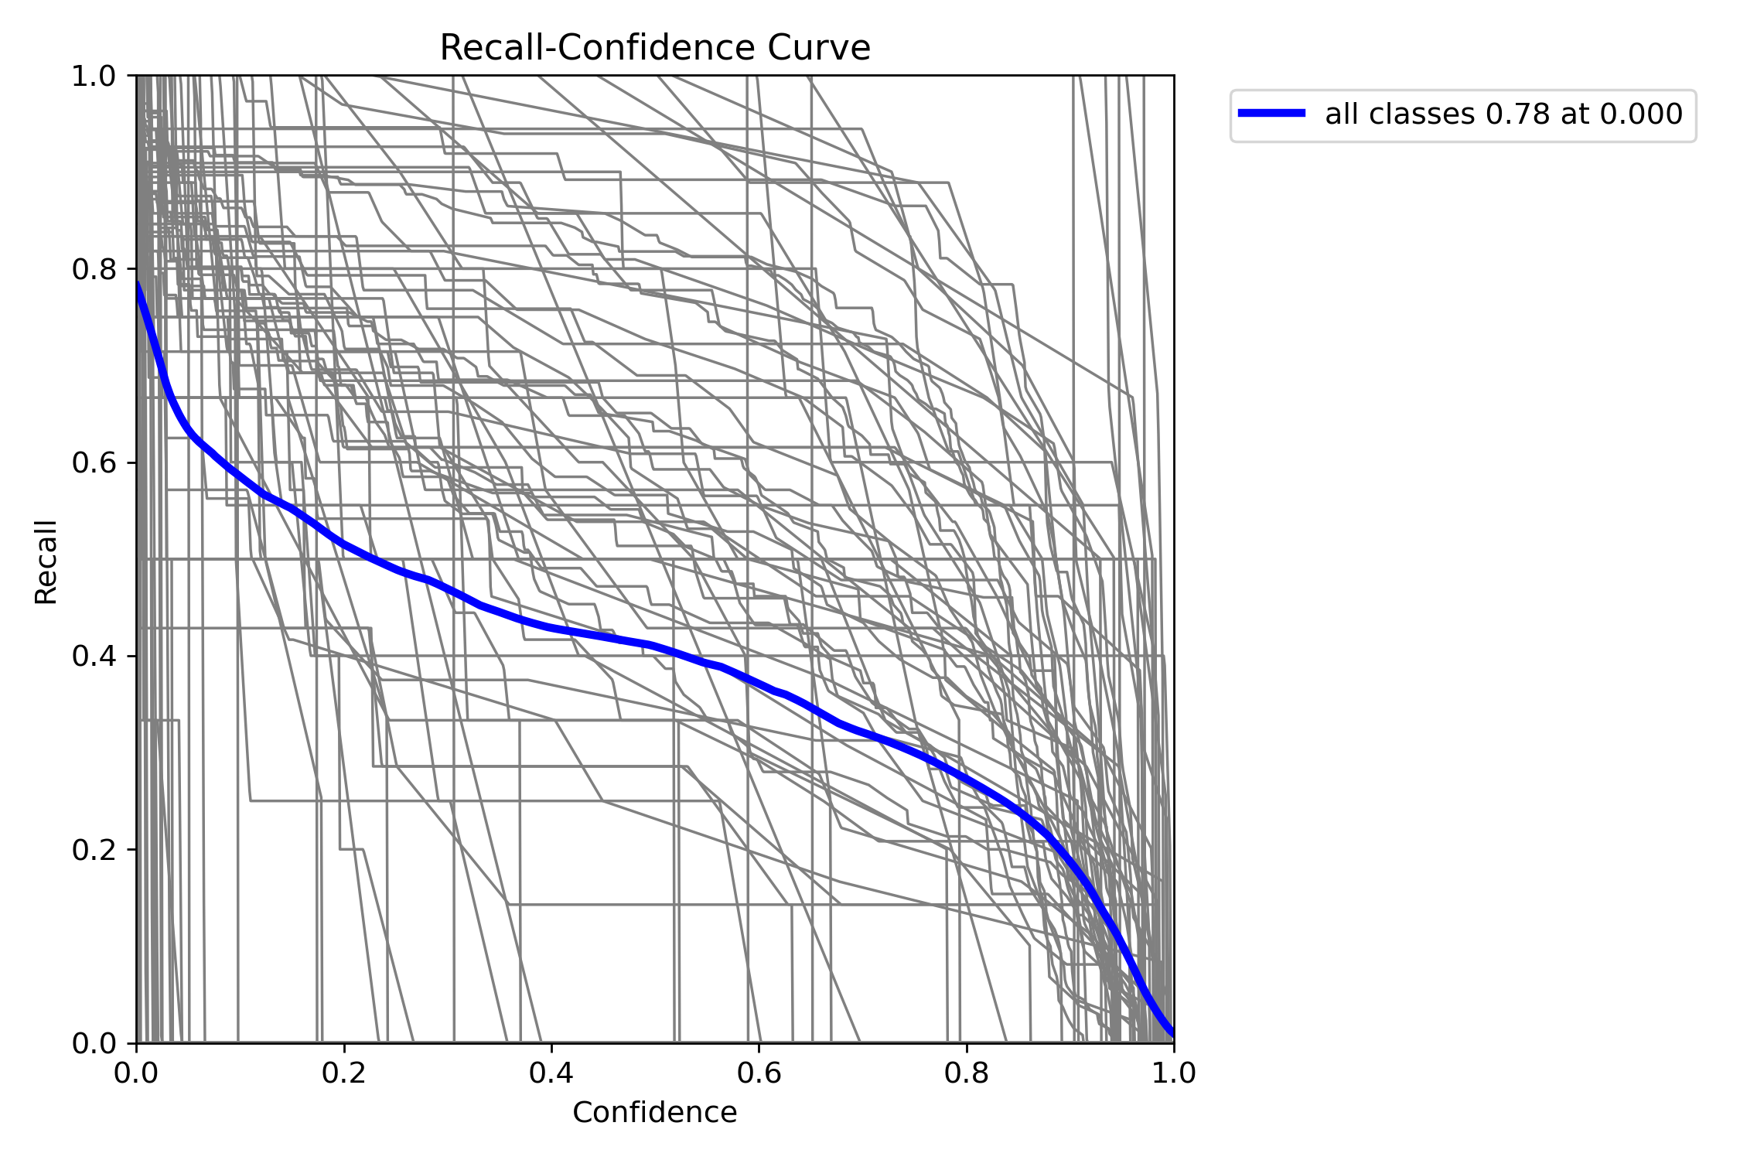
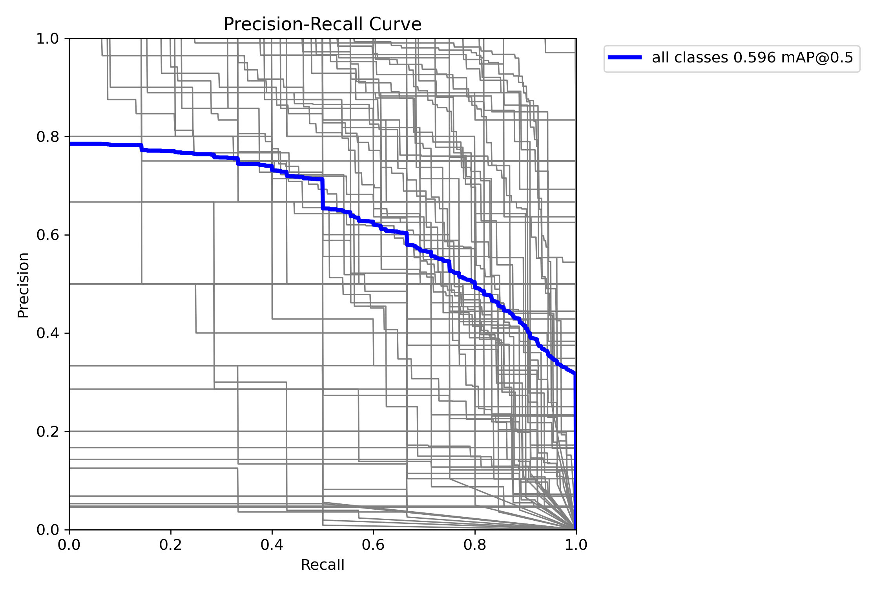
Baseline
240-Epoch YOLOv8x
Precision
-Confidence
Recall
-Confidence
Precision
-Recall

Slide 23
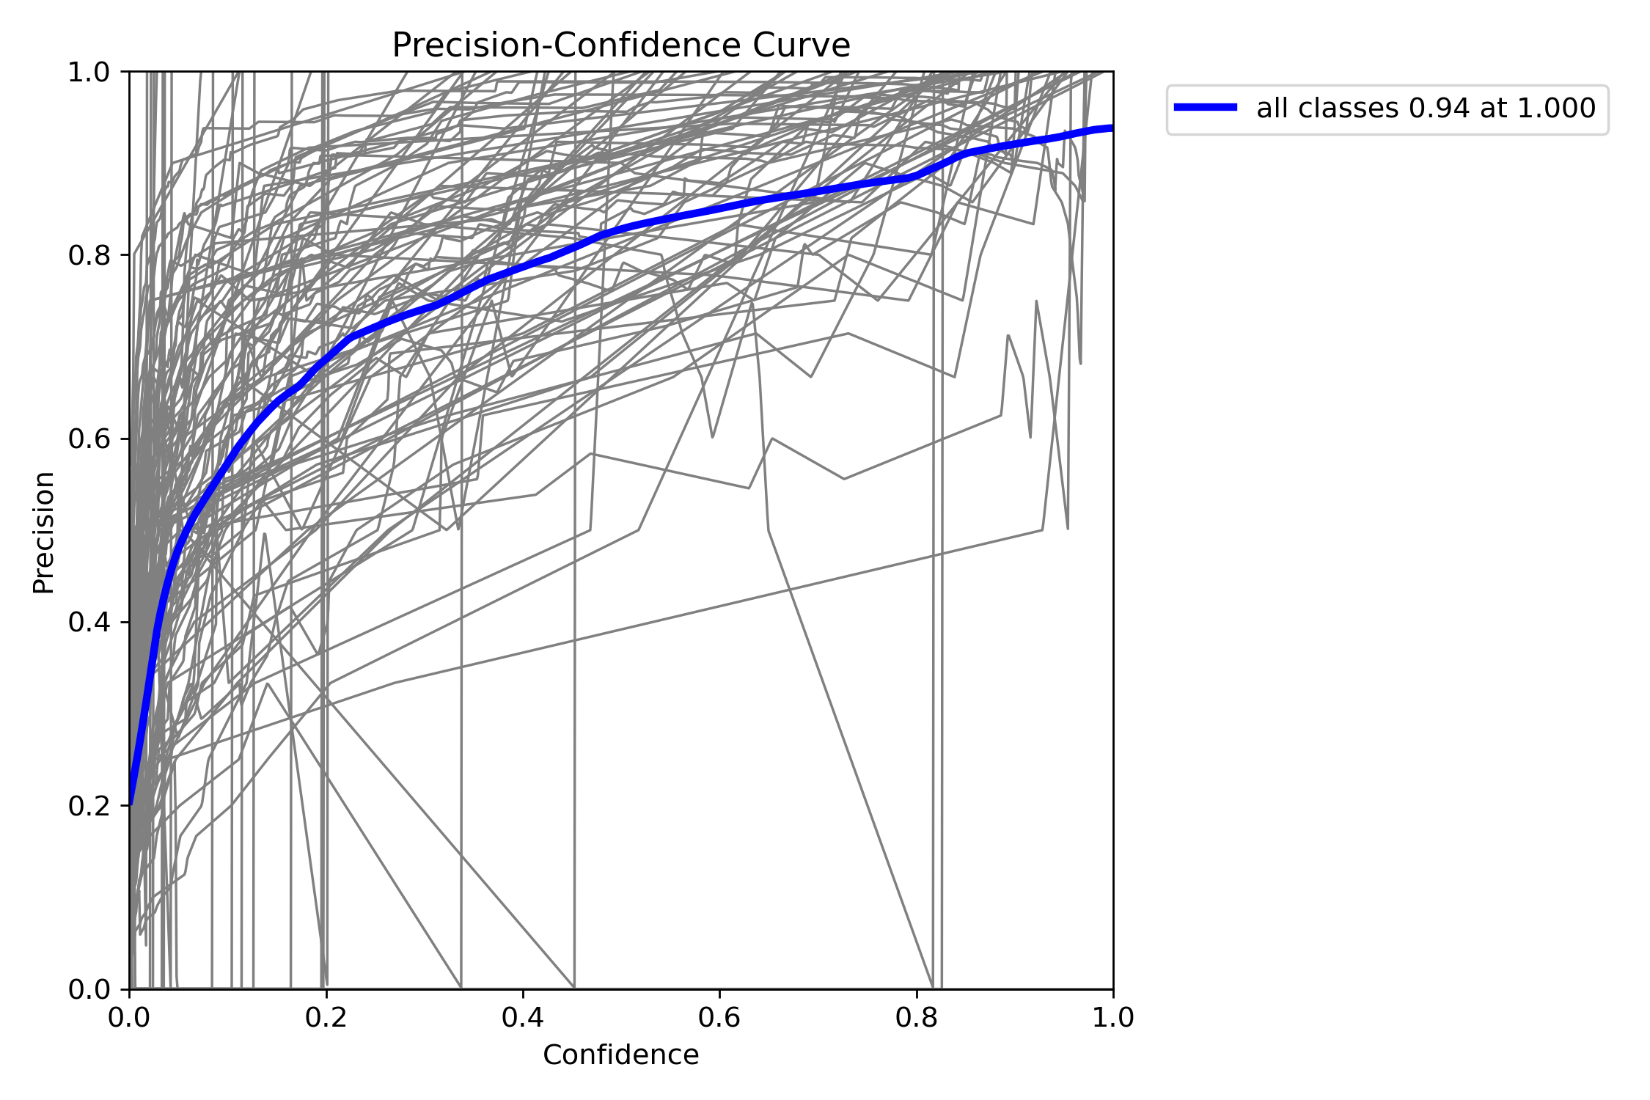
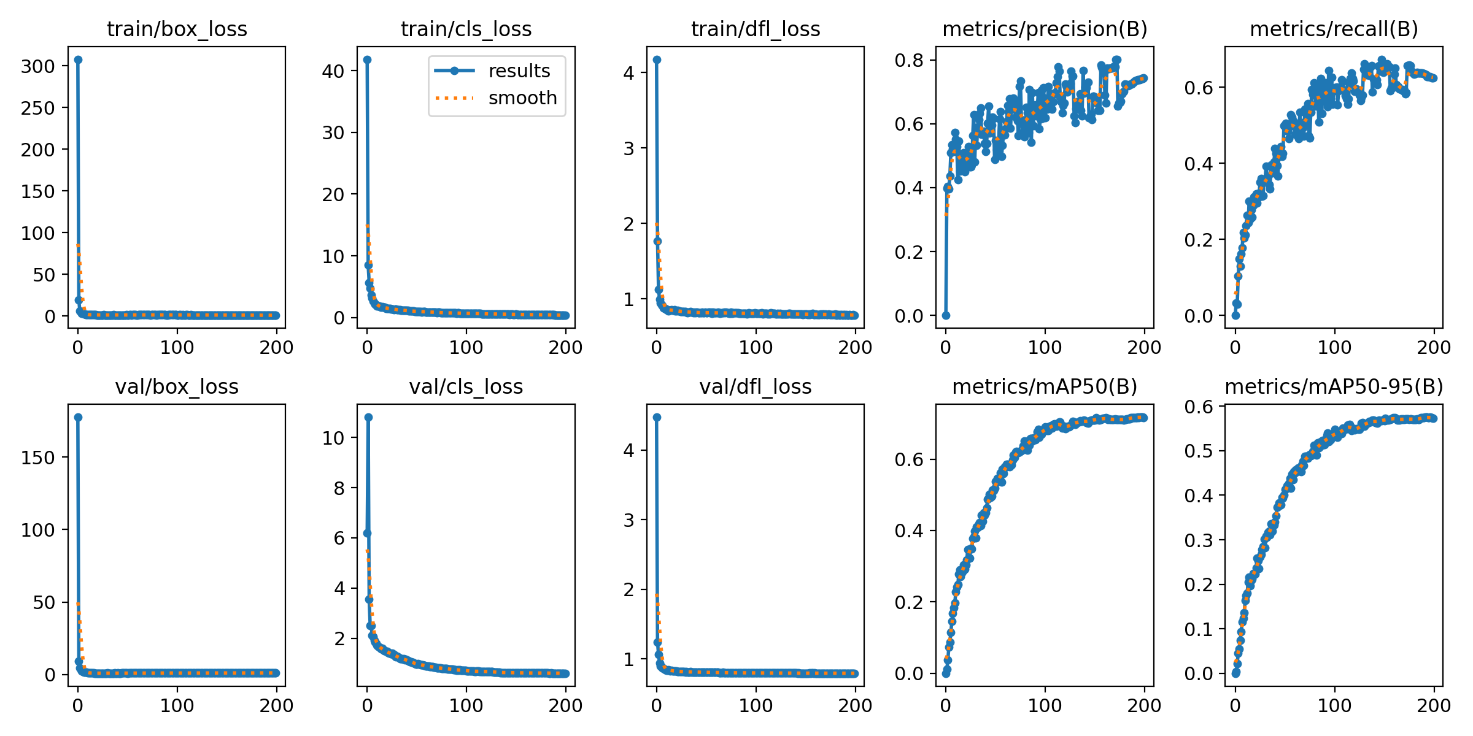
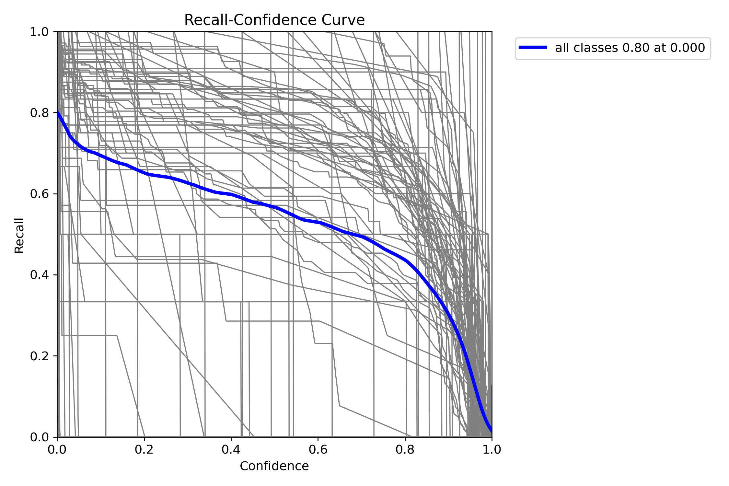
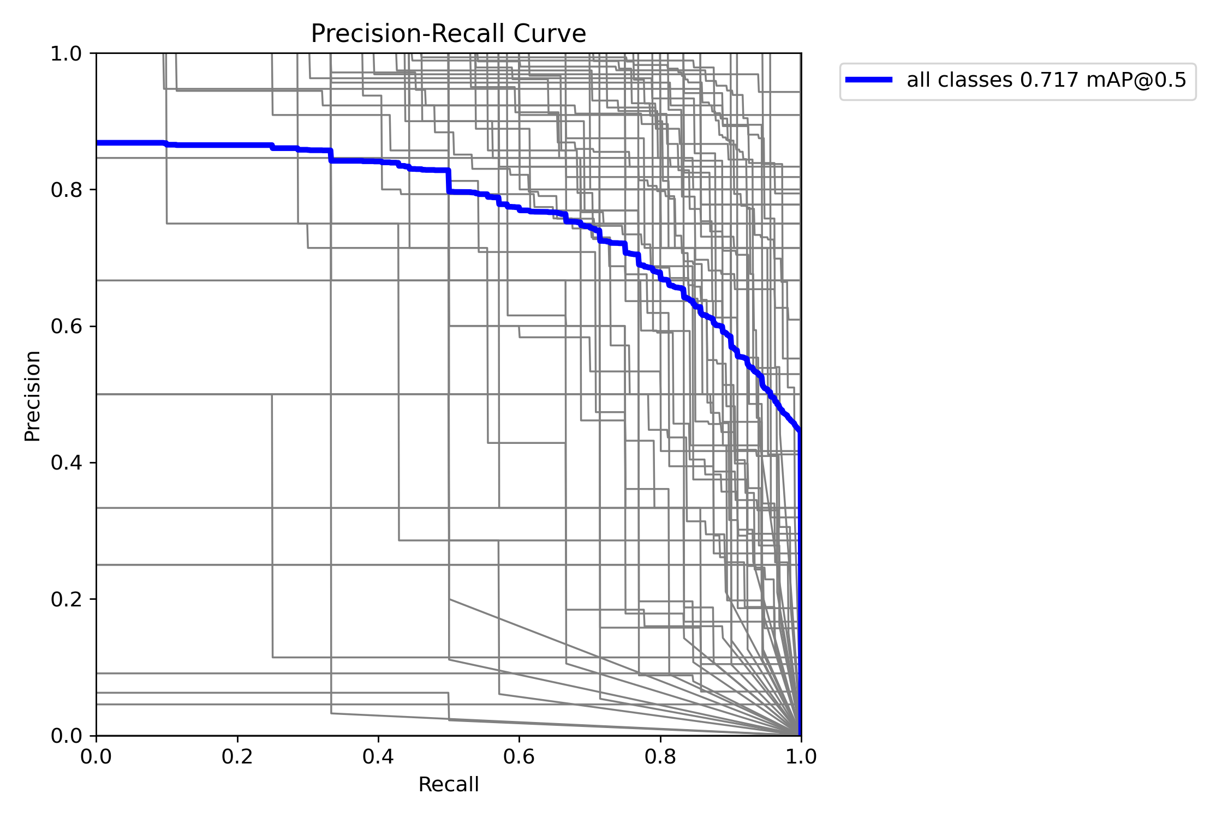
SE-boost model
200-Epoch YOLOv8x_SE
Precision
-Confidence
Recall
-Confidence
Precision
-Recall

Slide 24
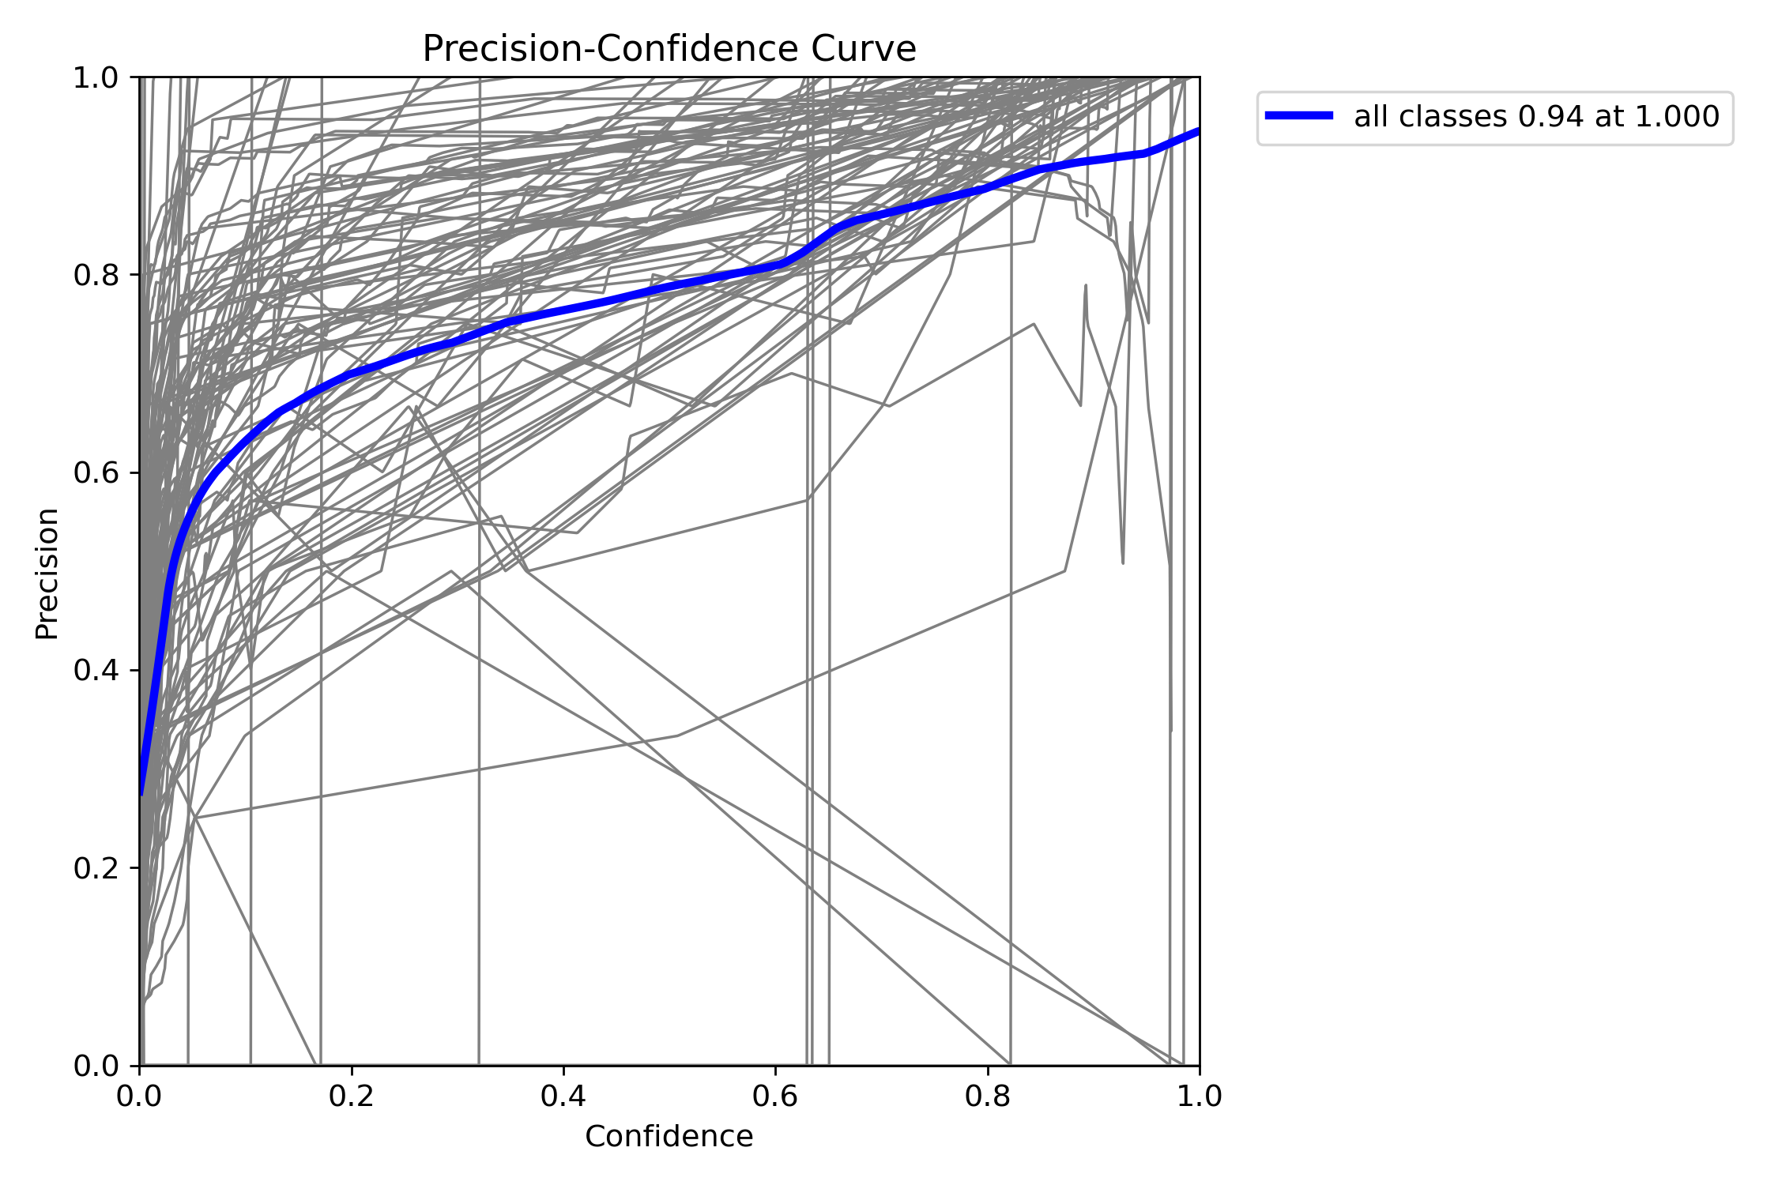
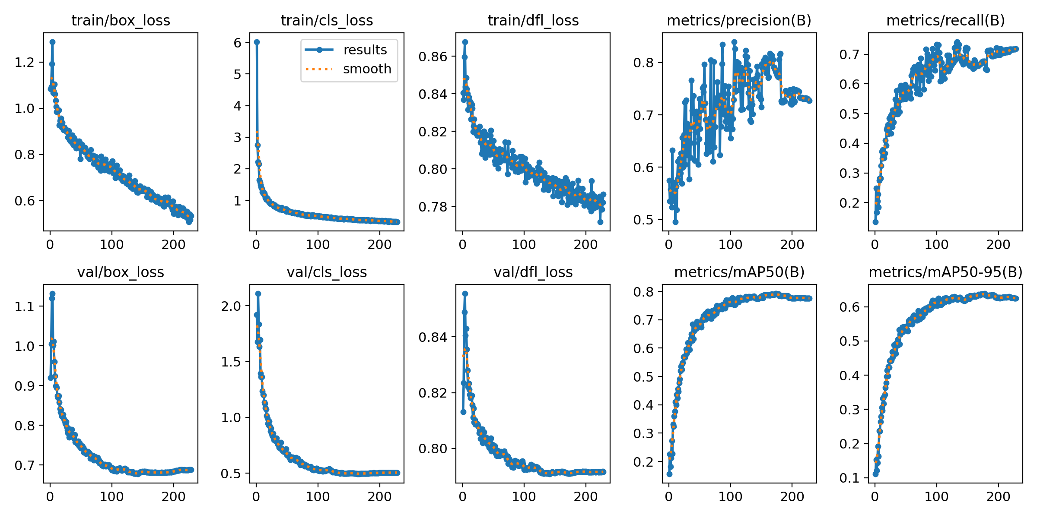
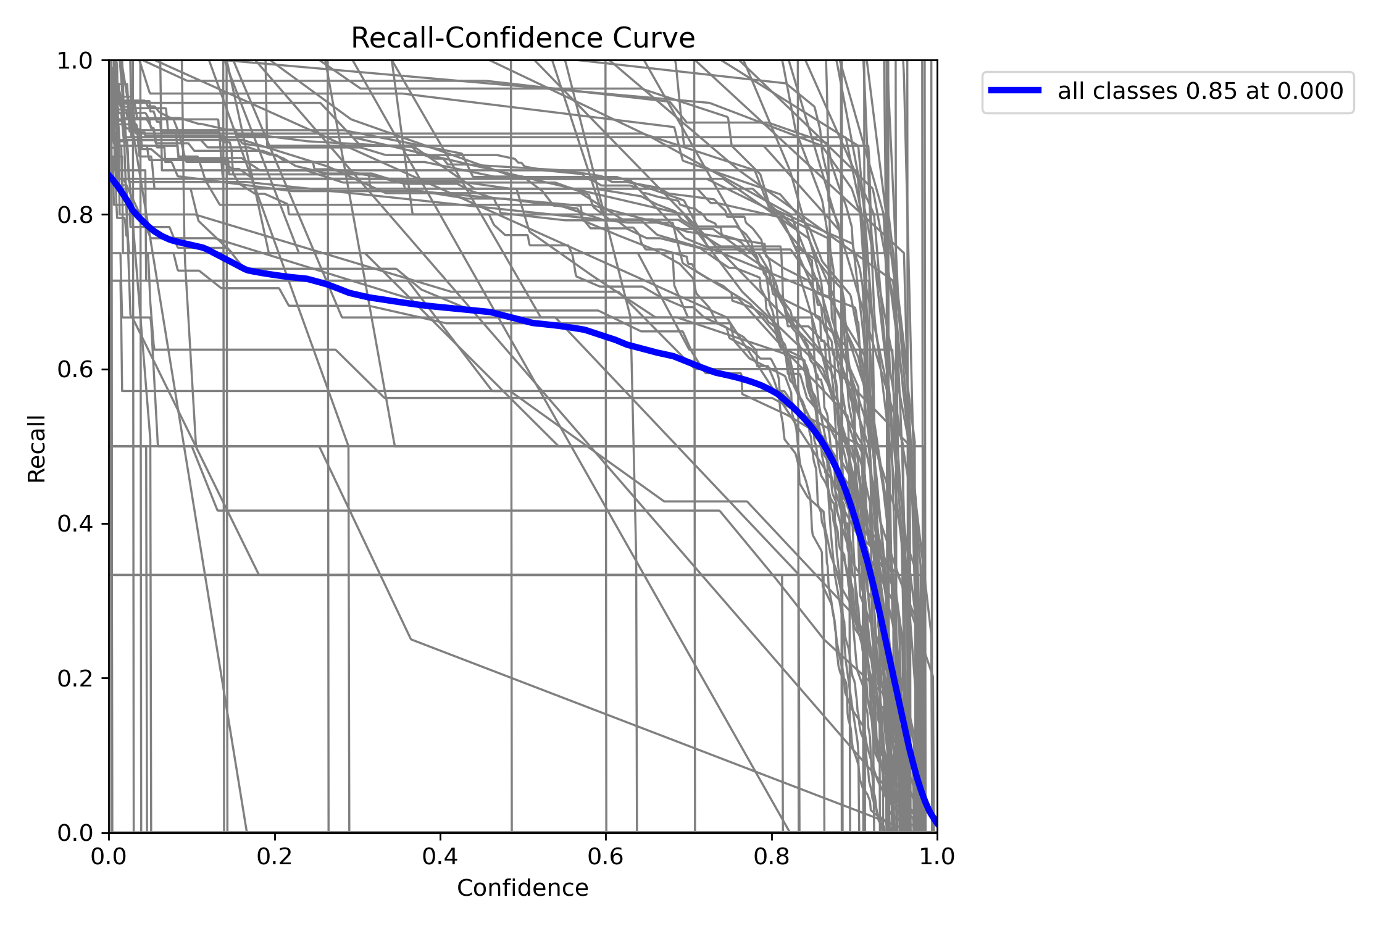
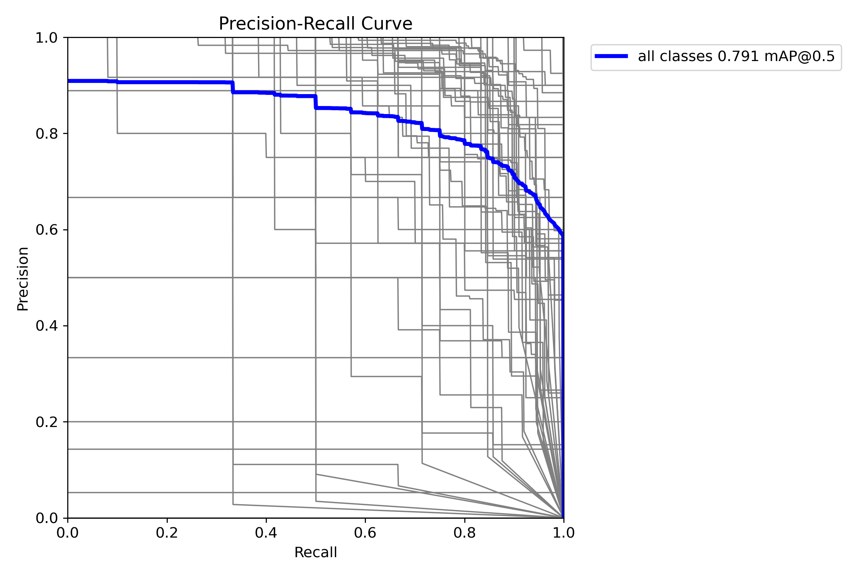
ECA-boost model
200-Epoch YOLOv8x_ECA
Precision
-Confidence
Recall
-Confidence
Precision
-Recall

Slide 25

Overall Results
Module | YOLOv8n | YOLOv8x | YOLOv8x_SE | YOLOv8x_ECA
Precision | 0.56819 | 0.72734 | 0.67563 | 0.7426
Recall | 0.55297 | 0.71765 | 0.63563 | 0.71436
Class_Loss | 0.67332 | 0.32077 | 0.4878 | 0.3502
mAP 50 | 0.59979 | 0.77619 | 0.71663 | 0.76952
mAP 50-95 | 0.46341 | 0.62487 | 0.57339 | 0.63443
Model Size | 6MB | 130MB | 522MB | 130MB
FLOPs | 33.64M | 43.61M | 49.34M | 43.64M

Slide 26
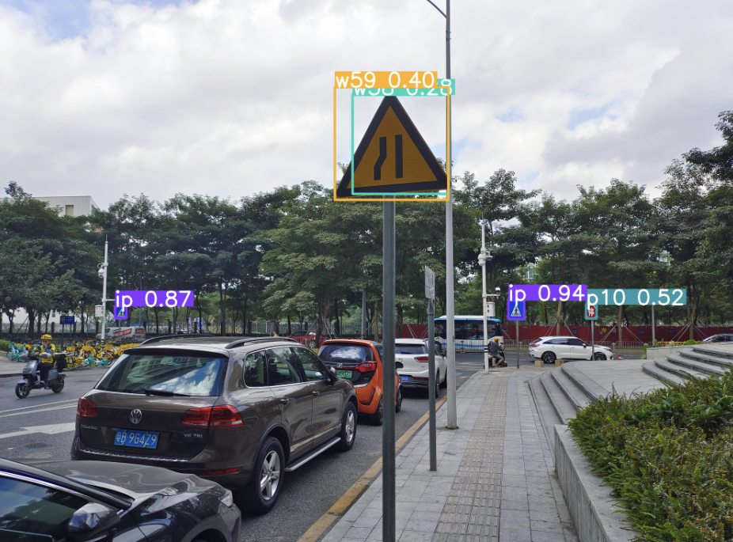
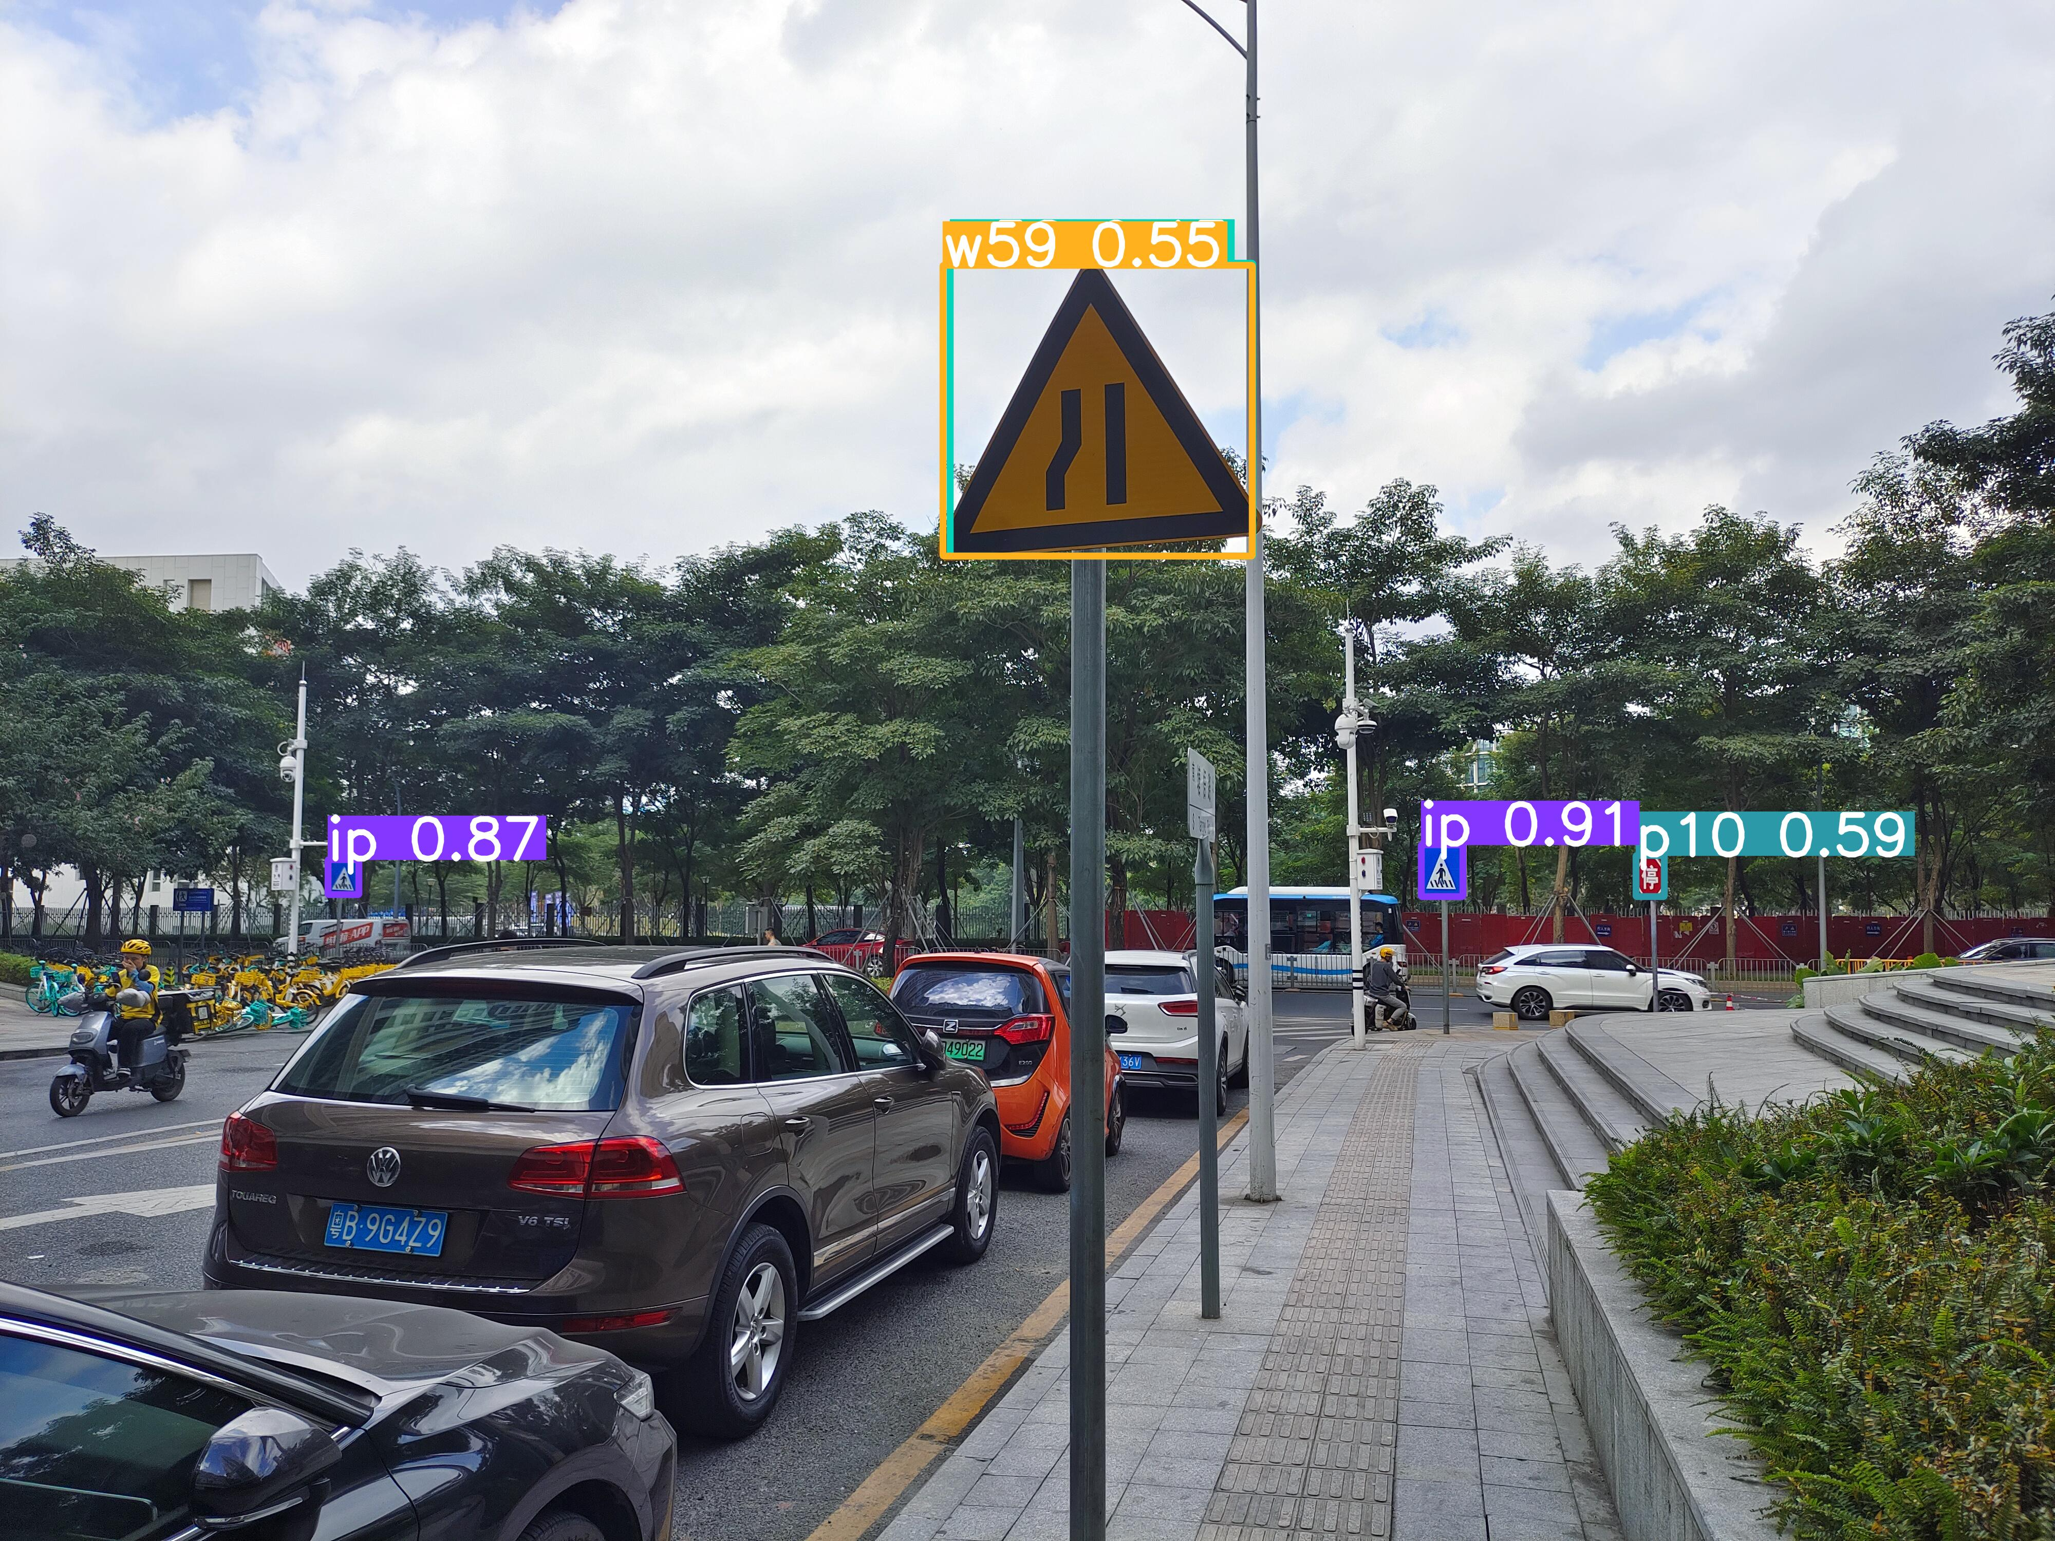
Comparison
YOLOv8x
YOLOv8x_ECA

Slide 27
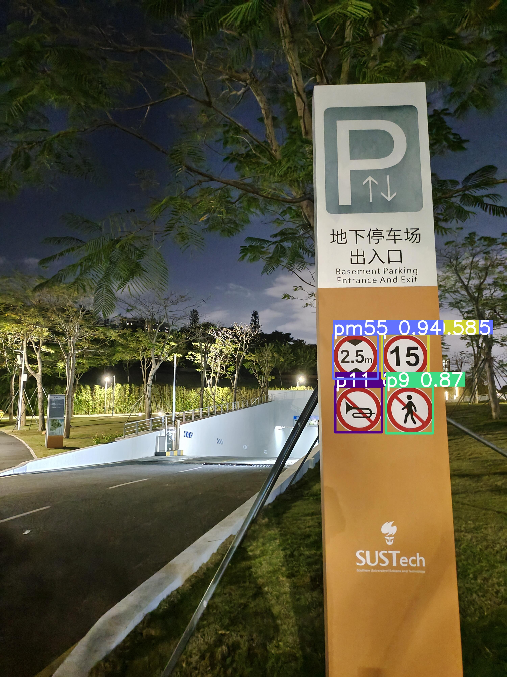
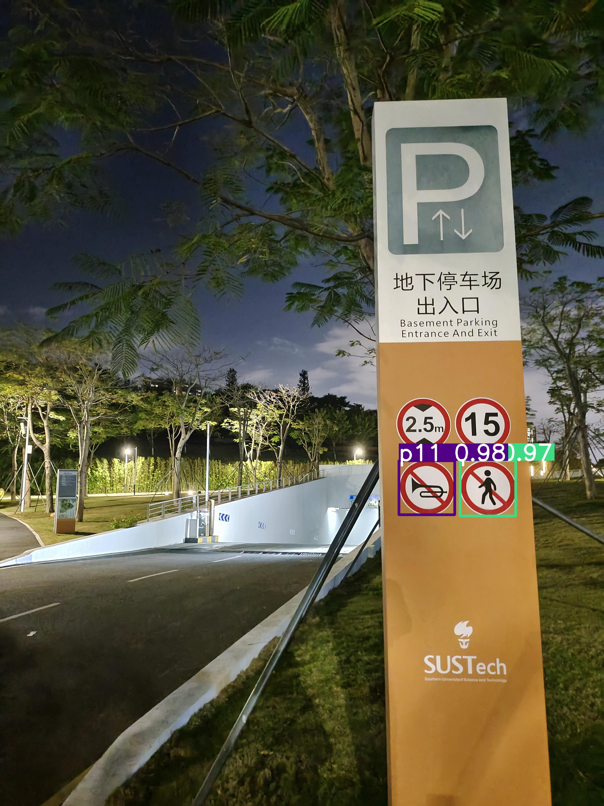
Comparison
YOLOv8x
YOLOv8x_ECA

Slide 28
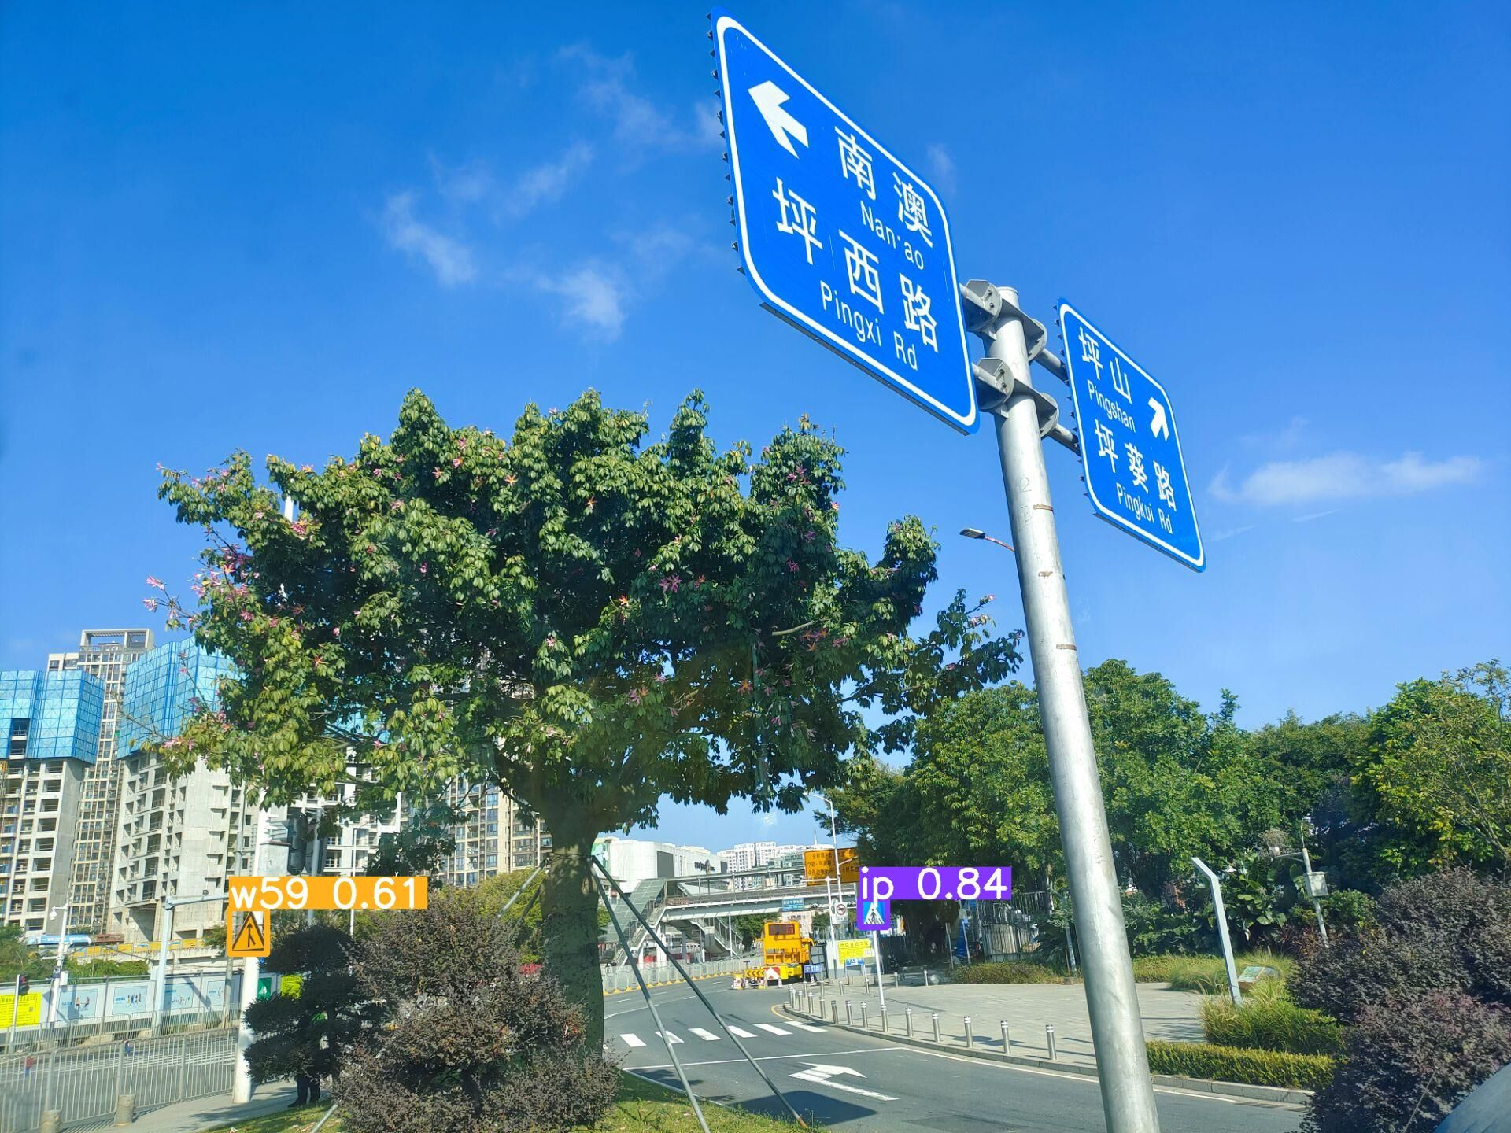
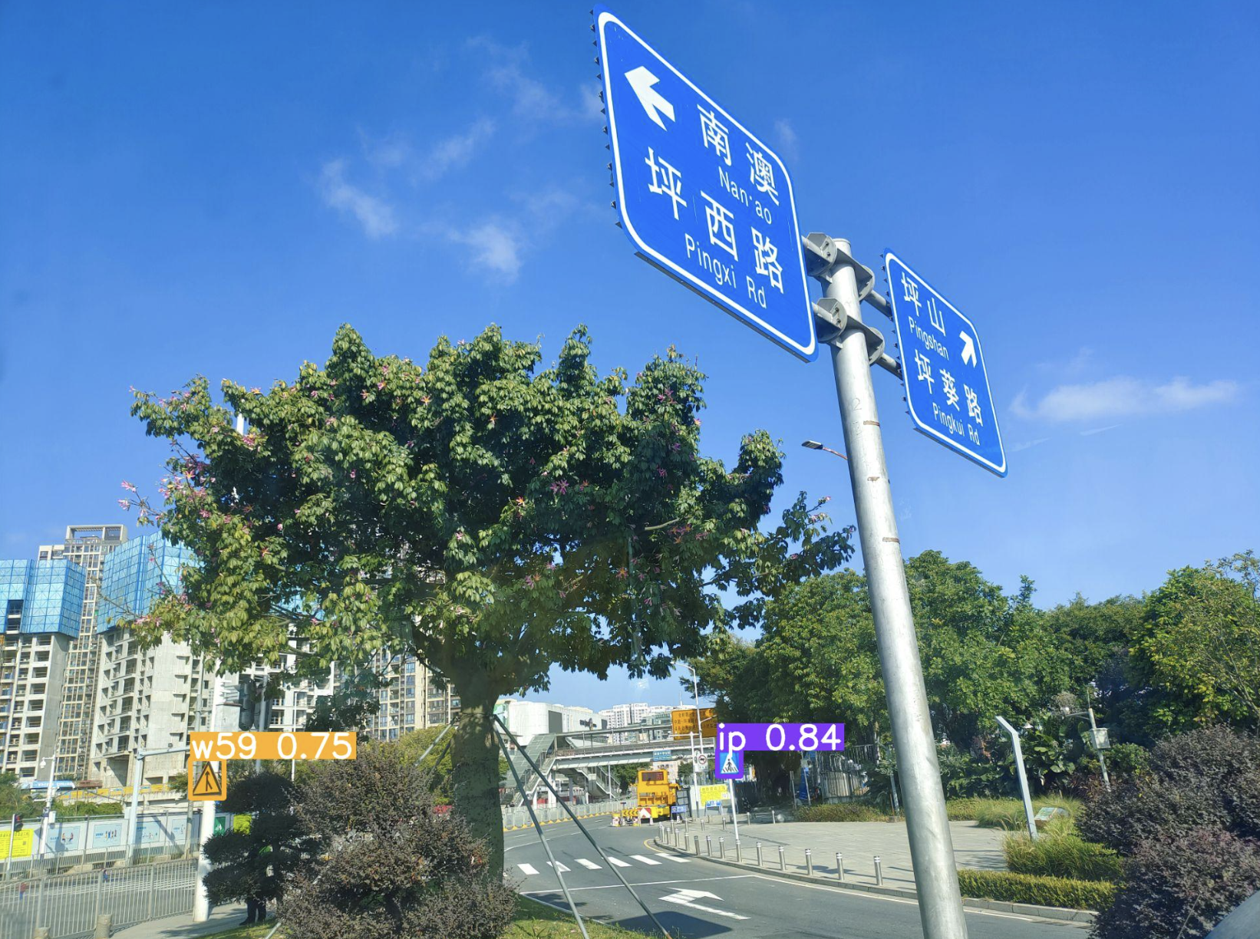
Comparison
YOLOv8x
YOLOv8x_ECA

Slide 29
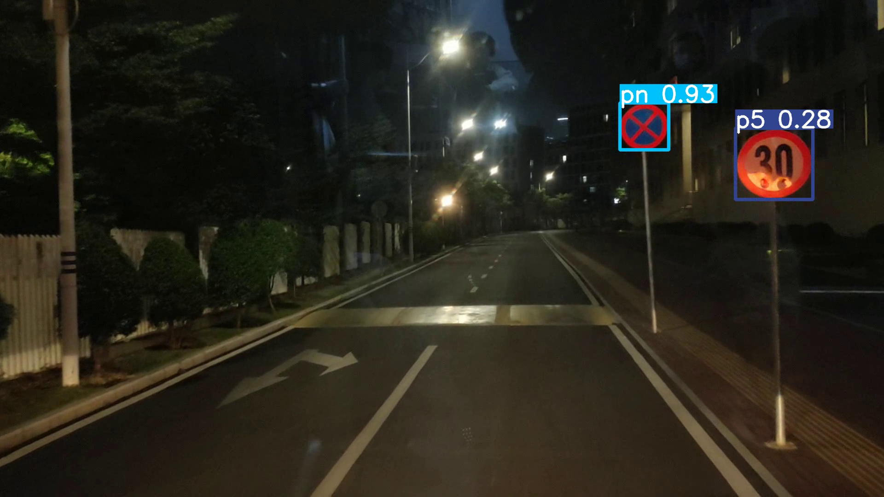
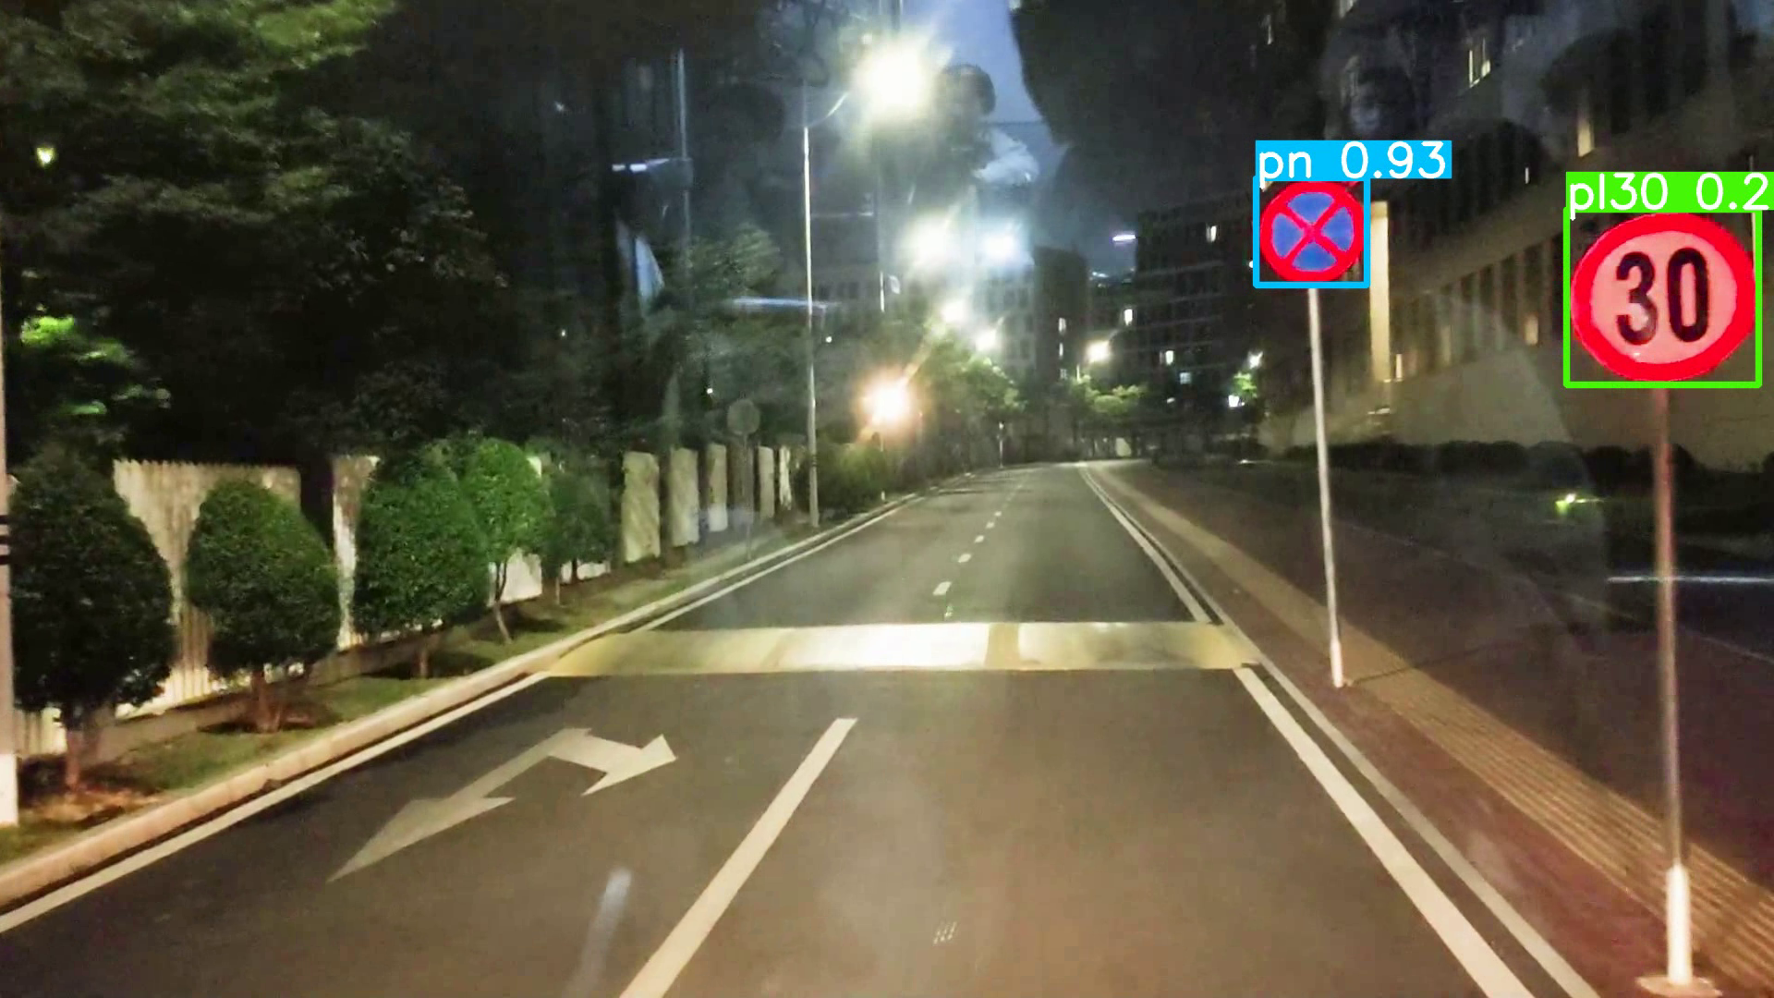
Comparison
Origin
Preprocessed

Slide 30
Comparison
Daylight
Night

Slide 31
Conclusion
Select YOLOv8x among several mainstream models
Use SE, ECA to enhance YOLOv8x
Shot a customize TSDR dataset
Models behaves worse for night condition
Solution 1: enrich the night dataset
Solution 2: use CV methods to preprocess the input

Slide 32
References
[1] Z. Zhu, D. Liang, S. Zhang, X. Huang, B. Li, and S. Hu, “Traffic-Sign Detection and Classification in the Wild,” 2016.
[2] J. Hu, L. Shen, S. Albanie, G. Sun, and E. Wu, "Squeeze-and-Excitation Networks," arXiv:1709.01507 [cs.CV], 2019.
[3] Q. Wang, B. Wu, P. Zhu, P. Li, W. Zuo, and Q. Hu, "ECA-Net: Efficient Channel Attention for Deep Convolutional Neural Networks," arXiv:1910.03151 [cs.CV], 2020.
[4] Song, W.; Suandi, S.A. TSR‑YOLO: A Chinese Traffic Sign Recognition Algorithm for Intelligent Vehicles in Complex Scenes. Sensors 2023, 23, 749.
[5] Zuo, Z.; Yu, K.; Zhou, Q.; Wang, X.; Li, T. Traffic Signs Detection Based on Faster R‑CNN. In Proceedings of the 2017 IEEE 37th International Conference on Distributed Computing Systems Workshops (ICDCSW), Atlanta, GA, USA, 5–8 June 2017.

Slide 33

Thank you!
Group Members
樊斯特 12111624
肖佳辰 12112012

